Slide 1

ASSEMBLING AN ANIMAL CASE
Anna Morrison-Ricordati
Amr law group, llc
111 W. Washington St., Ste. 1900, Chicago, IL

Slide 2
ASSEMBLING AN ANIMAL CASE
CIVIL LAWSUITS INVOLVING ANIMALS – PLAINTIFF’S PERSPECTIVE
Animal Custody Disputes
Fraud/Misrepresentation
Housing Disputes and "No Pet" Policies
Shareholder Actions to Benefit Animals
Veterinary Malpractice
Wrongful Death or Injury to Companion Animals

Slide 3
ASSEMBLING AN ANIMAL CASE
TOPICS
Animal Custody Disputes
Fraud/Misrepresentation
Housing Disputes and "No Pet" Policies
Shareholder Actions to Benefit Animals
Veterinary Malpractice
Wrongful Death or Injury to Companion Animals

Slide 4
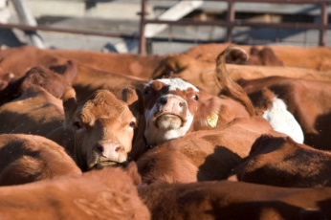

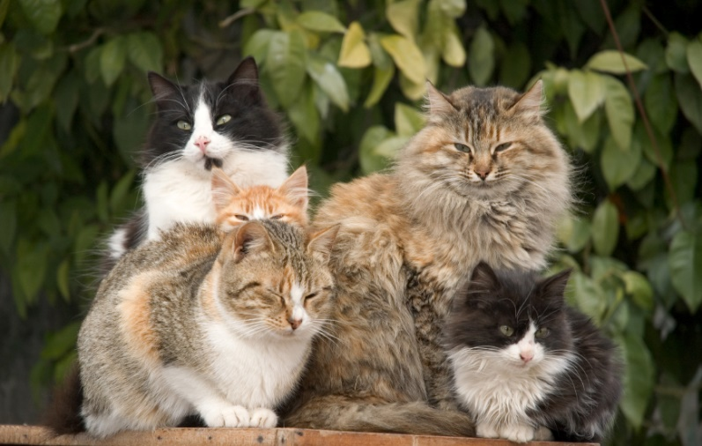
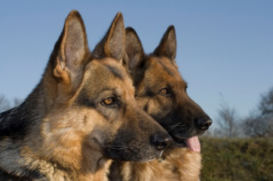
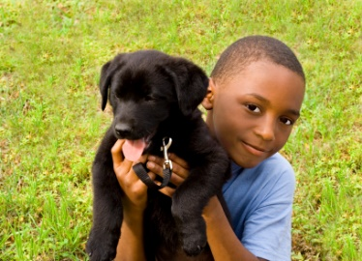
The Clients
Animal Protection Organizations
Business Owners
Champion (Show) Animal Owners
Companion Animal Owners/Guardians

Slide 5



The Clients
Animal Protection Organizations
  Standing Issues
  Interest in Intentional Cruelty Cases
  Shareholder Actions
Business Owners
  Contract Issues
  Dog Bites (Animal Injury)
Champion (Show) Animal Owners
  Traditional Property Type Case w/ Variants
Companion Animal Owners/Guardians
Notes:
BO - Contract: Barring something to the contrary – no, cannot hold animal if services not paid (can sue in court); If animal abandoned, good idea to have contract provisions as to what a business can do.
CAP – “market valuation” often does apply – some issues of speculative damages, etc.
CAO – unchartered territory

Slide 6
The Clients
Companion Animal Owners/Guardians
Fraud/Misrepresentation
    Animal Purchase from Pet Store
    Can Involve Other Statutes/Laws (Ex: IL Consumer Fraud v. IL Puppy Lemon Law)
    SOL - Fraud
Intentional Cases (Cruelty, Torture, IIED)
    Person Kills or Harms Companion Animal – Intent Required
    Can Involve Other Statutes/Laws (Ex: IL Humane Care for Animals Act; TN Law)
    SOL – Personal Injury
Veterinary Malpractice
    Negligence Type – Mistake/ Professional Standards
    Can Involve Contract; Fraud; Other Statutes/Laws (Ex: Vet Practice Act)
    SOL: Malpractice & Property & Fraud & Other
Negligent Death or Injury to Companion Animals
    Accident / Mistake / Res Ipsa (Ex: Boarding; Bite from Another Dog; Grooming Accident; Escape from Dog Walker)
    SOL: Property & Other

Slide 7
The Clients
Key Questions – Initial Consultation
  Against whom? [Conflicts & Private v. Govt. Actor]
  When? [Statutes of Limitations]
  What happened? [Intentional v. Negligent Act]
  What paperwork is involved? [Contracts, Waivers, Etc.]
  What do you hope to gain by bringing lawsuit?
Managing Expectations
  Damages Will Vary
  Can Be Costly (Filing Fees, Transcripts, Experts)
  Evidence May Not Be Admitted
  Emotional Investment
  Public Scrutiny
  Outcome Difficult to Predict
Notes:
Seemingly very basic information, but very important … may be a conflict with animal business client – may be too late – damages may be too low to merit bring suit (available damages vary drastically by state) – will discuss other options in later presentation.
Remember – Civil Suit Can usually ONLY seek $$$ Damages – Cannot Discipline (Veterinarian), Cannot Prosecute (Criminal), Cannot Enjoin (except in rare situations or settlement)
PRACTICE TIP: *Initial consultation – 15 min – do not provide legal advice, but can provide information to see if good fit*
Expectations: Very important to realize that this may be the first lawsuit person ever involved in … new to legal system … private individual must consider costs
Expectations: Very hardest thing I do is explain to client that the law considers his/her animal “property” – and will limit & in some cases deny emotional damages
Expectations: May have very damning evidence of what believe happened … may not be allowed … may have evidence defendant is truly horrid person … may not be allowed

Slide 8

The Other Side
Important Considerations
Business or Professional
    Reputation
    Insurance Paying for Defense
Government
    Immunities
    Insurance Paying for Defense
Individual
    Ability to Find
    If No Insurance, May Not Be Able to Collect

Slide 9

Fraud / Misrepresentation
Examples – Taylor, Case No. 09-M5-000363
The dog Opie and seller Happiness is Pets (HIP)
Month of Inquiry & Discussion about Opie
  $200 deposit (was to be refunded or applied to purchase)
  One point – puppy “out for surgery” (neutering)
  HIP represented Opie came to HIP from USDA licensed breeder & Owner of “Blue Ribbon”
  No medical issues; APR = AKC; “family tree” info. available for $20 to APR
Spotted Italian Greyhound, purchased for approx. $800 (reduced price – older puppy)
Day after purchase, Opie had difficulty breathing → Emergency Vet Care South
Called HIP, informed all vet care would be paid by HIP – wasn’t reimbursed

Slide 10
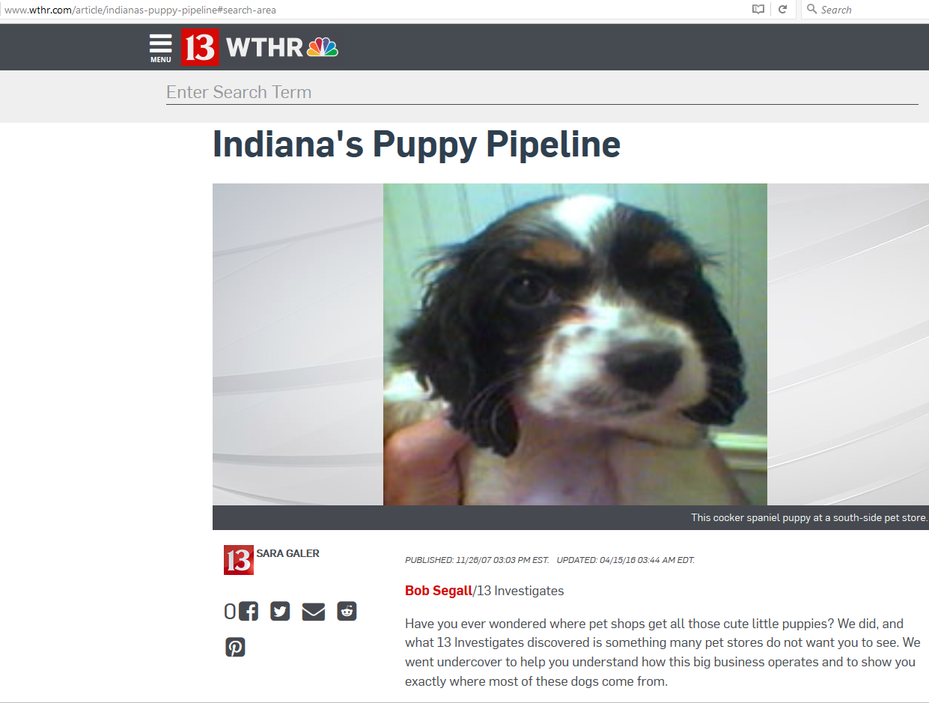
Fraud / Misrepresentation
Examples – Taylor
Regular vet visit → Informed Opie not neutered & continued respiratory issues
  Later learned “out for surgery” – being treated for loose stool & vomiting
Research into breeder → Not person stated & broker was “Levi Graber”
  No pedigree available from APR
No refund of $200 deposit
No reimbursement for neuter & emergency vet
No microchip registration
Opie had Girardia and Coccidia, among other health issues

Slide 11
Fraud / Misrepresentation
Example: Taylor
Claims:
  Fraudulent Concealment
    Intention to refund $200
    Neutered status of puppy
    APR v. AKC
    Broker involvement
  Fraud
    Bad Faith Scheme
  Other Claims
    Breach of Written Contract
    Breach of Oral Contract
    Negligent Misrepresenetation
    Injunctive Relief

Slide 12
Fraud / Misrepresentation
Elements of Fraud
  (LA) Fraud is a misrepresentation or a suppression of the truth made with the intention either to obtain an unjust advantage for one party or to cause a loss or inconvenience to the other. Fraud may also result from silence or inaction.
Damages Available
  Enhanced
  Punitive or (LA) Attorneys Fees
Evidence of Fraud
  (LA) Fraud need only be proved by a preponderance of the evidence and may be established by circumstantial evidence.
  Other States: clear and convincing evidence is required.
Notes:
Art. 1953. Fraud may result from misrepresentation or from silence
Fraud is a misrepresentation or a suppression of the truth made with the intention either to obtain an unjust advantage for one party or to cause a loss or inconvenience to the other. Fraud may also result from silence or inaction.
Acts 1984, No. 331, §1, eff. Jan. 1, 1985. 1, eff. Jan. 1, 1985.
Fraud need only be proved by a preponderance of the evidence and may be established by circumstantial evidence.
Acts 1984, No. 331, §

Slide 13
Fraud / Misrepresentation
Example: Taylor
Important Considerations
  Pre-litigation Investigations - FOIA
  Discovery (Schemes)
  Public Interest in Puppy Mills
Outcome
  Settlement (Terms Confidential)

Slide 14
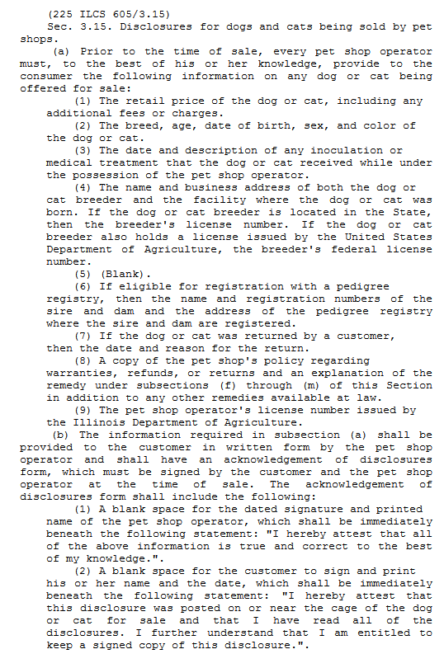
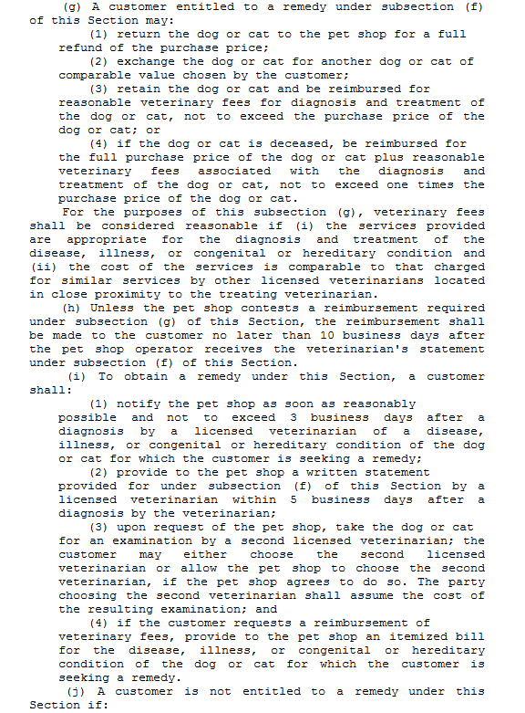
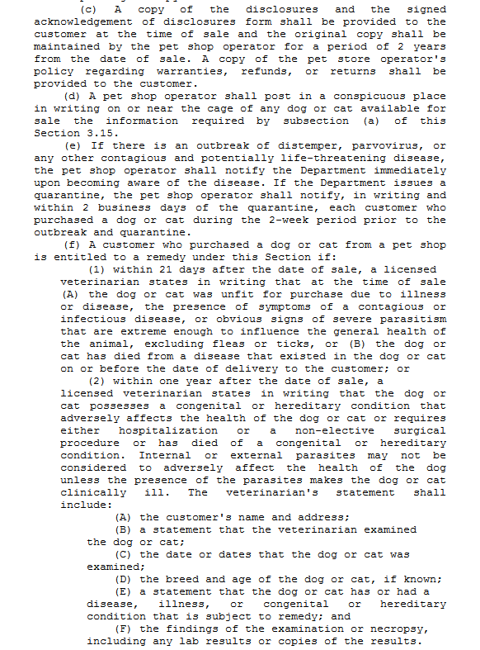
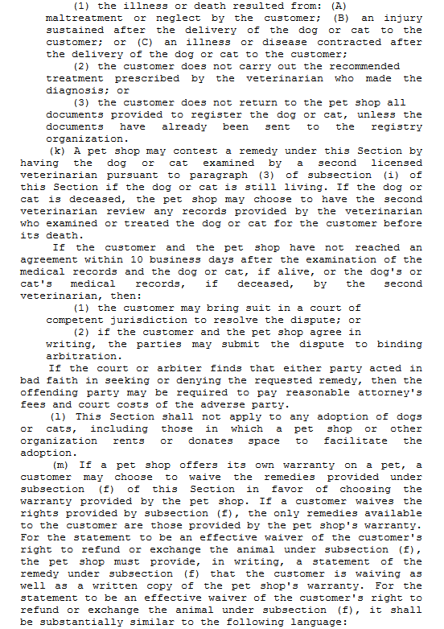
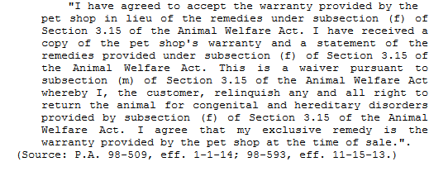
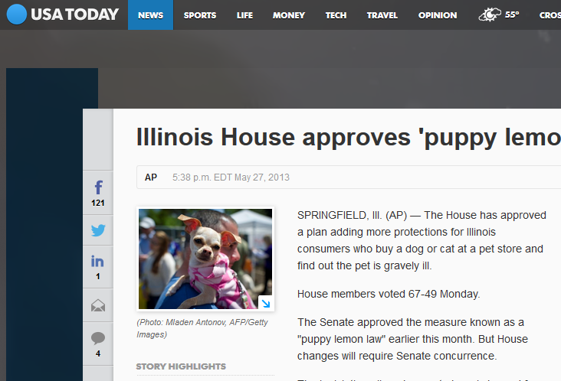
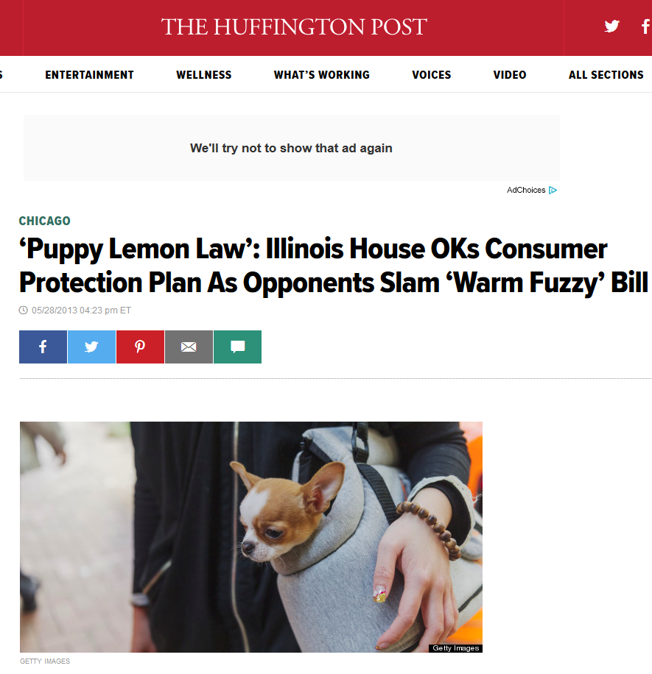
Fraud / Misrepresentation
Examples – Taylor – Since Replaced by IL Puppy Lemon Law
Notes:
AVMA cites 21 states with specific laws … https://www.avma.org/Advocacy/StateAndLocal/Pages/pet-lemon-laws.aspx
Really – any state with consumer fraud laws or basic fraud laws – has a remedy … likely a far better one

Slide 15
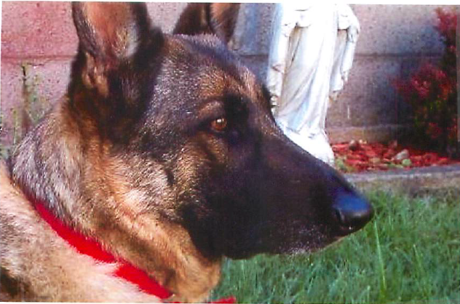
Fraud / Misrepresentation
Examples – Dafnis, 2014 L 004161
The dog Milly, guardian/owner Corey Dafnis, & veterinarian Matthews (Calumet Animal Clinic)
CAC - Small Veterinary Practice (one vet, a couple techs)
March 21, 2014 - Milly (5 year old, healthy German Shepherd) brought in for spay surgery; assured surgery was safe for Milly & told Milly needed to stay overnight for observation following surgery
March 22, 2014 – Ms. Dafnis received call that Milly had died overnight
  Told Milly died of hemophilia
March 22, 2014 – Milly brought to second vet for necropsy

Slide 16
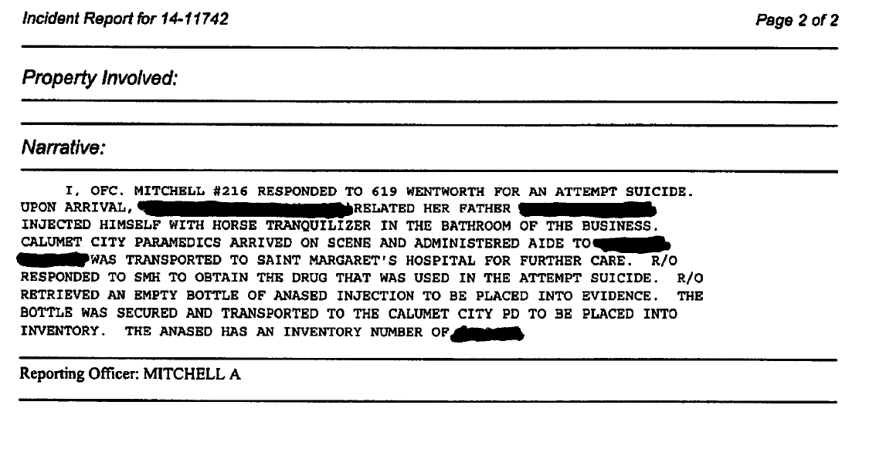
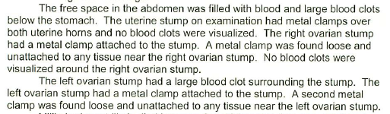
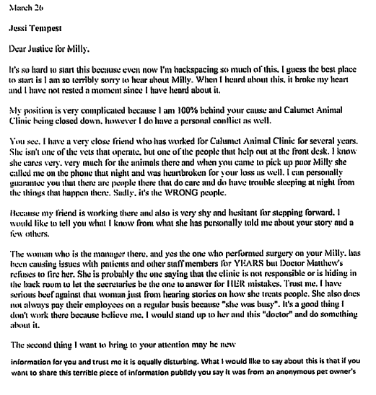
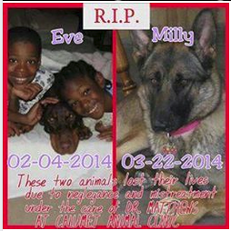
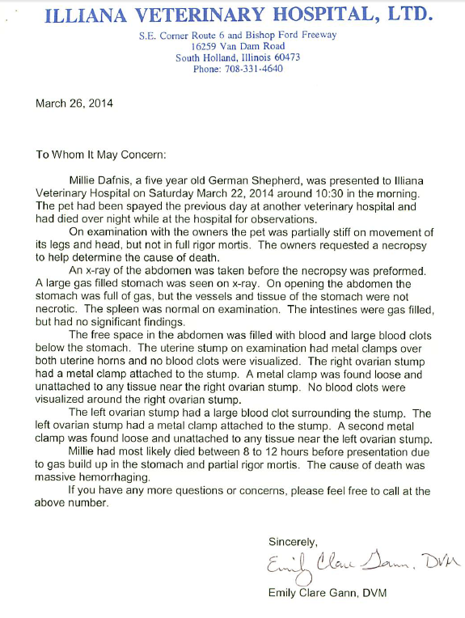
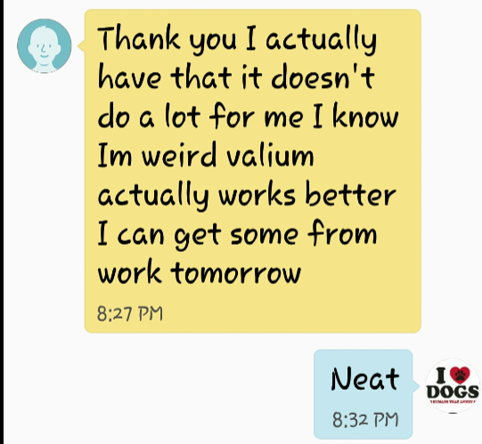
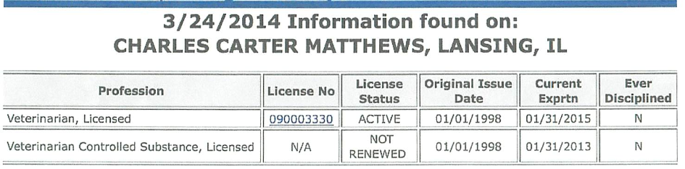
Fraud / Misrepresentation
Example: Dafnis
Later Learned
  Milly’s abdomen filled with blood due to one or more loose clamps (she bled out)
  Matthews was not licensed to administer controlled substances
  No persons checked on Milly “periodically” during the overnight stay
  Information received/alleged that surgeries being performed by techs (staff)
  Information received/alleged that techs (staff) engaging in questionable behavior
  Information received/alleged that persons at clinic took drugs intended for animals at clinic
  Not the first dog to die under similar circumstances at clinic
Notes:
Illinois – dual licensure state – need both State and Federal license to administer controlled substances

Slide 17
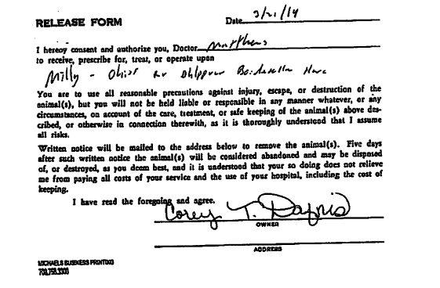
Fraud / Misrepresentation
Example: Dafnis
Complication:
  Exculpatory Clause in Form
Claims:
  Fraud in the Inducement
    (representations made before signing form)
  Fraud/ Misrepresentation
    (no license; false claim that dog died of hemophilia;
    periodic checks)
  Fraud/ Concealment “
Other Claims:
  Professional Malpractice (breach of reasonable standard of care)
  Humane Care for Animals Act (cruelty)
  Negligence (breach of ordinary care)
  Respondeat Superior (responsible for agent’s actions)

Slide 18
Fraud / Misrepresentation
Example: Dafnis
Important Considerations
  Pre-litigation Investigations – Licensing Info., FOIA
  Attorney Correspondence = Admissions
  Public Interest – News Coverage
  Social Media – FB Pages & Supporters
  Involvement of IDFPR – Disciplinary Review
  Exculpatory Clause Potentially Unenforceable

Slide 19

Media in Cases with Acts Against Animals
INVOLVEMENT OF NEWS/MEDIA
  Dafnis Case
  Trying Case in Court v. Public Opinion

Slide 20
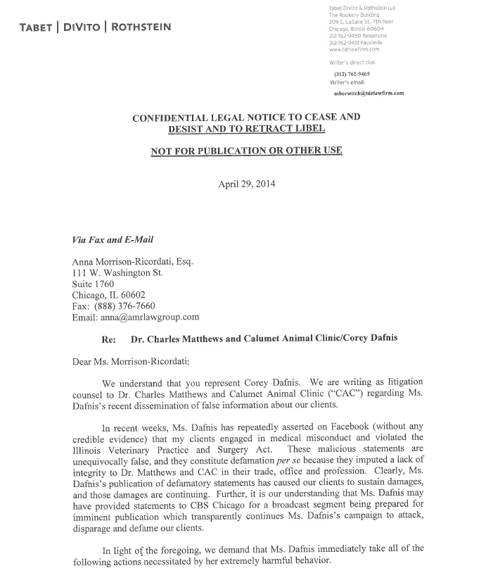
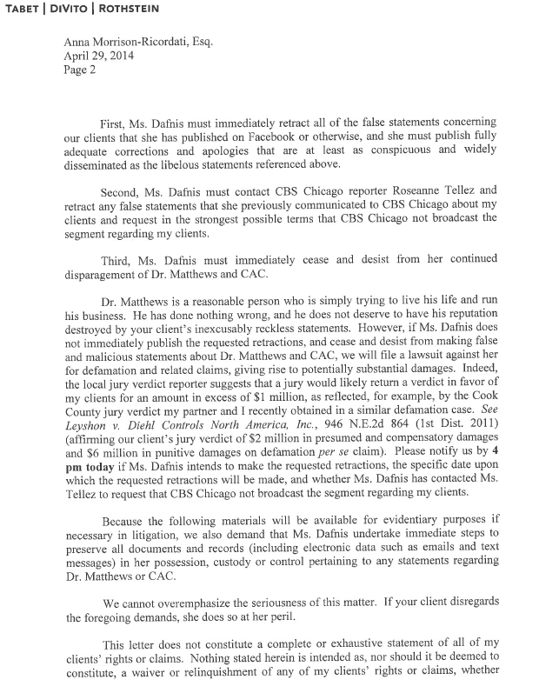
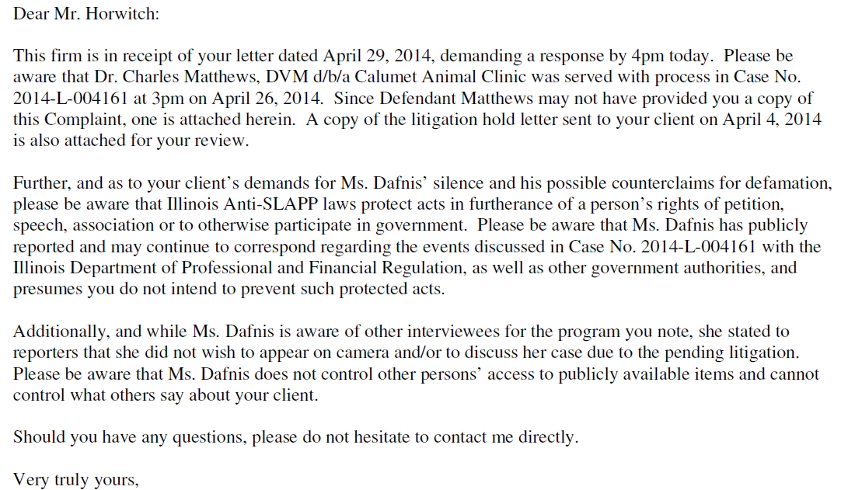
Media in Cases with Acts Against Animals
INVOLVEMENT OF NEWS MEDIA
  Dafnis Case
    Not the only instance of potential misconduct.
    Defendants did NOT want Plaintiff appearing on camera.

Slide 21
Media in Cases with Acts Against Animals
INVOLVEMENT OF NEW/MEDIA
Problem (for Attorney) if Litigation is Anticipated or Underway
  Ethics Rules May Prohibit
    By Filing Suit, You Have Agreed to Submit Dispute to Courts
    Publicity Can Taint a Jury Pool
  Client Statements Are Recorded & Now Evidence
  Client May be Misquoted or Portrayed Negatively
  May Destroy Settlement Talks
  May Bring Counterclaim for Defamation
  May Encourage Court to Issue Gag Order
  May Stall Civil Case if Criminal Prosecution Results

Slide 22
Media in Cases with Acts Against Animals
INVOLVMENT OF NEWS/MEDIA
Benefits
  Brings a Public Matter to Light
  May Encourage Others to Speak
  May Allow You to Gauge Community Reaction
  May Give Rise to Additional Claims
  May Resolve Dispute More Quickly/ Directly

Slide 23
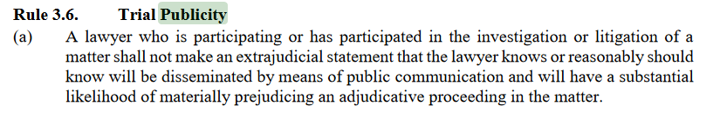
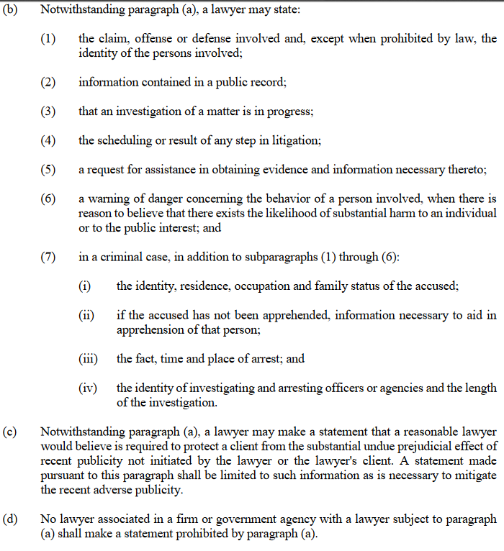
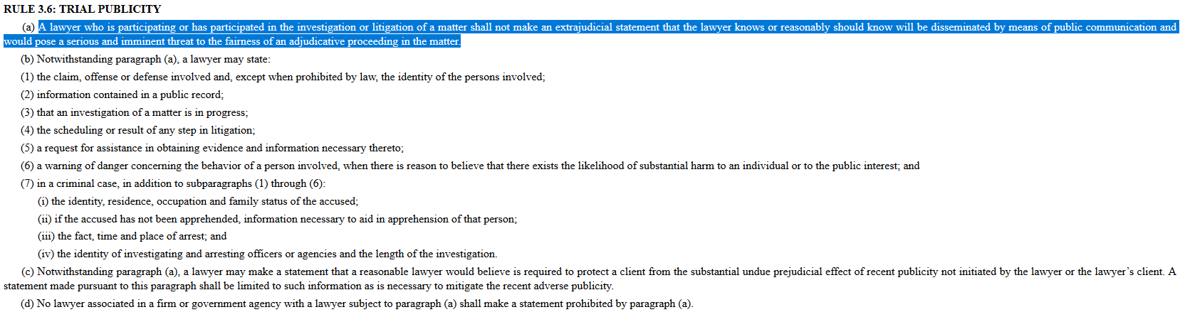
Media in Cases with Acts Against Animals
INVOLVEMENT OF NEWS/MEDIA
Attorney May Be Asked For Statement
  Refer to Ethics Rules
  Refer to Publicly Filed Documents
  Even if Responding to Accusations or AFTER Case Concludes – Need Client Approval
Client May Be Asked For Statement
  Warn/Advise Client of Potential Negative Consequences
  Be Present for Recording
  Be Prepared for Fallout

Slide 24

Intentional Acts Against Animals
Elements of Intentional Act
  (LA) In this case, the basic standard applicable to the defendant is that he must not intentionally invade or interfere with, the physical integrity of the plaintiff. By “intentionally”, I mean the purpose or state of mind with which a person acts.
  (LA) Intent means that the person either (1) consciously desires the physical result of his actions or (2) knows that the result is substantially certain to follow from his actions. A defendant who is guilty of an intentional tort is liable for all of the consequences of his actions, even those which he did not actually intend or which were not reasonably foreseeable.
Damages Available
  Compensatory Losses
  Emotional Distress
Evidence of Intent
  Admission
  Eyewitness
  Circumstantial
Notes:
Example: IIED
14:10. Intentional infliction of mental distress
A person who intentionally or recklessly causes severe emotional distress to another by virtue of extreme and outrageous
conduct is liable for that emotional distress and for any bodily harm as a result.
By extreme and outrageous conduct, I mean conduct which is so extreme in degree and so outrageous in character, as to go
beyond all possible bounds of decency and is to be regarded as atrocious and utterly intolerable in a civilized community.
In order to recover for intentional infliction of emotional distress, the plaintiff must establish that (1) the conduct of the
defendant was extreme and outrageous, as I have defined that term for you; (2) the emotional distress which the plaintiff
suffered was severe; and (3) the defendant desired to inflict severe emotional distress or knew that severe emotional distress
would be certain or substantially certain to result from his conduct.

Slide 25
Intentional Acts Against Animals
Example – Dafnis
  Defendant did NOT have a license to administer controlled substances
  Controlled substances necessary to prevent pain during surgery
  Surgery performed without controlled substance would cause pain
  PRACTICE POINTER: **Veterinarians use a number of controlled substances – different DEA regulations attach to each class. Some substances used during surgery (propafol) are not controlled. Other substances are used to immobilize and do not prevent pain.**

Slide 26
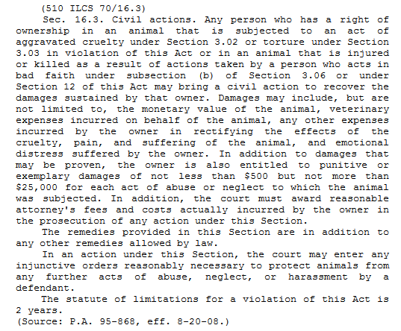
Intentional Acts Against Animals
Example – Dafnis
  Illinois – Specific Statute
  Humane Care for Animals Act (510 ILCS 5/70)
Important Consideration:
  Criminal Charges =
  Possible Delay in Civil Case

Slide 27
Intentional Acts Against Animals
Example – Green
  Police shooting
  Involves Constitutional Violations (Civil Rights - Sec. 1983)
  Note: Government Actors – in particular police – qualified immunities
    Acts of Negligence are protected
    Willful and Wanton conduct is not protected
Important Considerations
  Preserve Information ASAP
    Preservation Letter (Litigation Hold Letter)
    FOIA (radio communications, video, reports, calls received, photos, etc.)

Slide 28
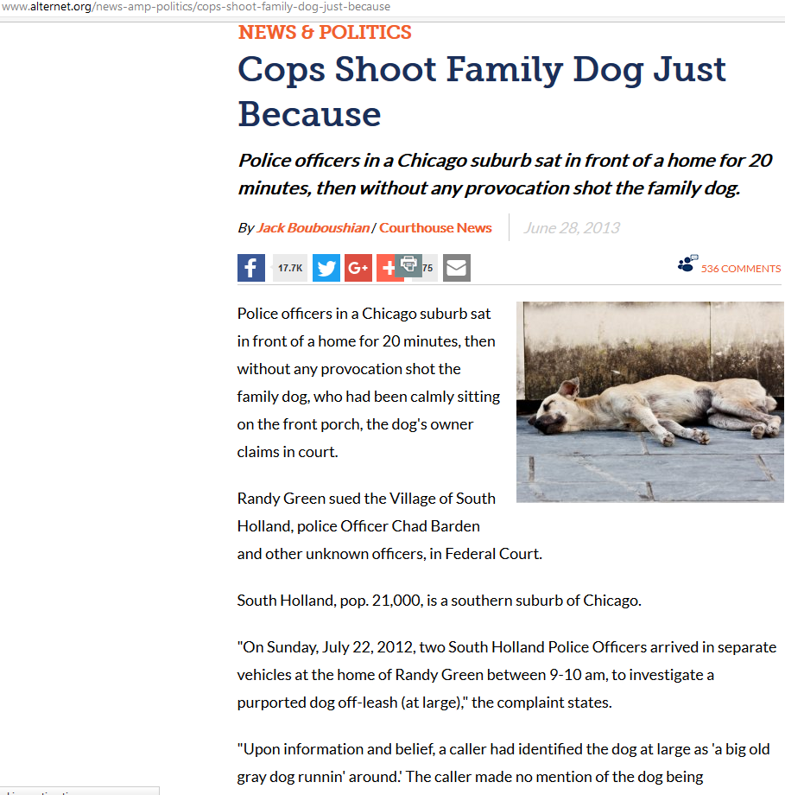
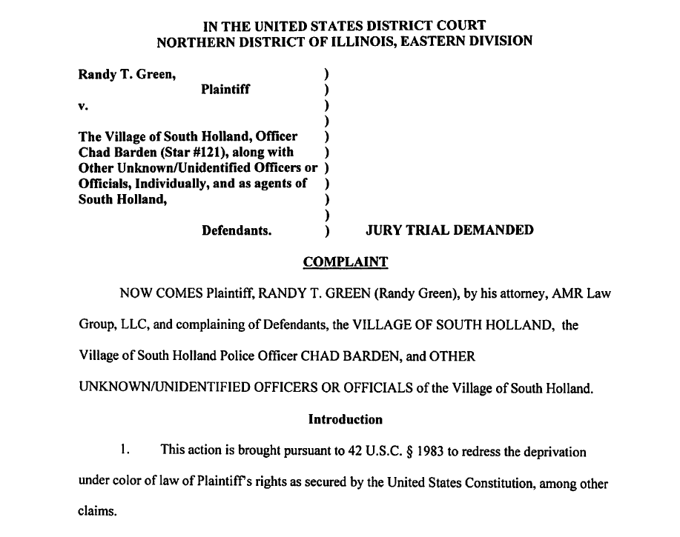
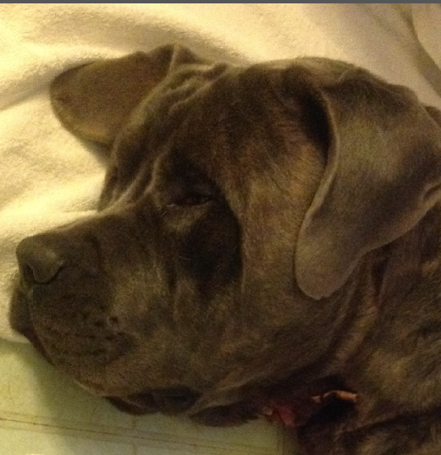
Intentional Acts Against Animals
INVOLVEMENT OF NEWS/MEDIA
  Green Case
    Animal Cases Draw Public Attention
    Filing May be Picked Up by Reporter
  CHECK ETHICS RULES
  BEFORE SPEAKING TO REPORTERS

Slide 29

Veterinary Malpractice
Elements of Veterinary Malpractice
  Breach of the reasonable standard of care that was proximate cause of injury/death
    What a reasonably prudent practitioner would do in the same or similar circumstances
    Higher standard for specialists (board certified)
    Will depend upon facts
  Res Ipsa Loquitur (that which speaks for itself)
    Example: Removing wrong leg; Excessive dosages of medications, etc.
Damages
  Jurisdictional – Negligence/Property Based
    Fair Market v. Actual Value
    Varies: cost to bring back to health; sentimental value; loss of companionship; mental distress
Evidence
  Typically involves expert testimony/evaluation of records

Slide 30
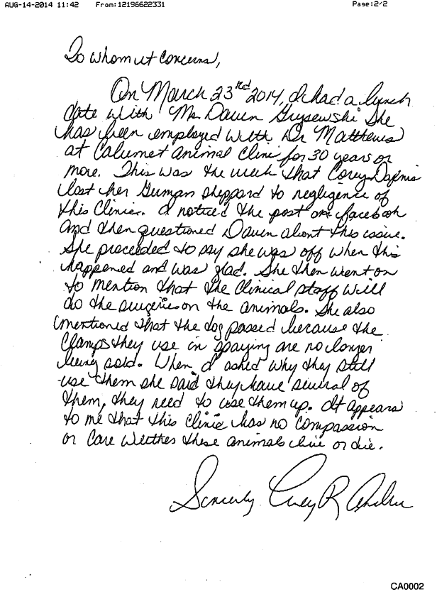
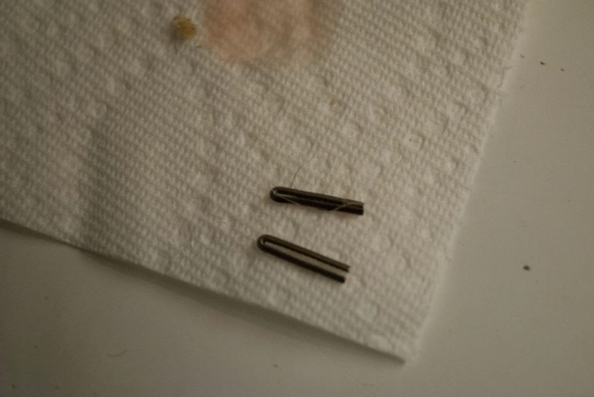
Veterinary Malpractice
Example – Dafnis
  Failure to have license not enough ….
  Must show actions were proximate cause
  of injury/death
  Alleged a number of ways
      Failing to use accepted surgical procedures (clips)
      Failure to use pain relieving drugs
      (note: must link to injury/death)

Slide 31
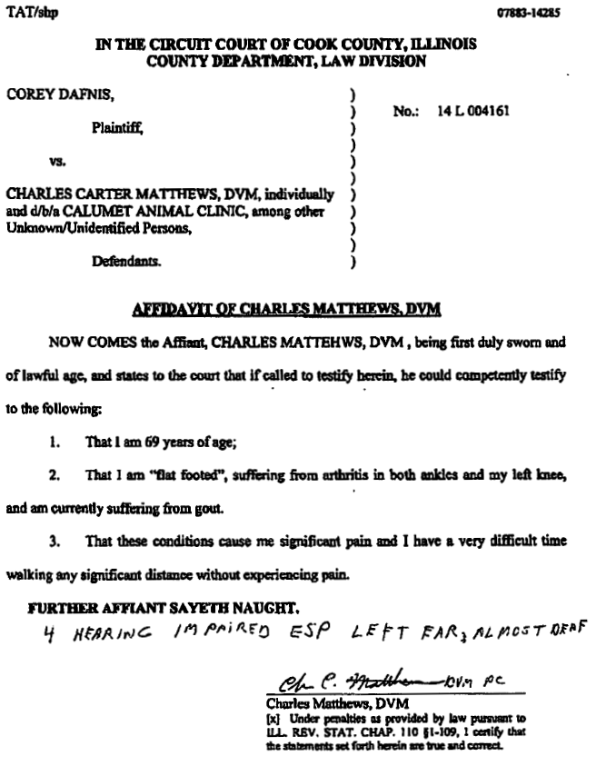
Veterinary Malpractice
Example – Dafnis
Important Considerations:
  Unexpected Issues (deposition →)
    Probative Value v. Protections
  State Disciplinary Involvement
    Get Records (If able – sometimes
    they do not match discovery provided)
  Social Media
    Witnesses – Fact Gathering
    Counterclaims (possible defamation)
    Allegations of Fraud (or using case to make $$$)
Notes:
August 8, 2014 – Defendant’s Opposition to Plaintiff’s Motion for Order to Issue Subpoena and for Access to Confidential Records.

Slide 32

Negligent Acts Harming/Killing Animals
Elements of Negligence
  Duty, Breach, Causation, Damages
    Ordinary care expected for a given activity
    (LA) Chapter 3 – Jury Instructions
*Damages for Negligence
  Compensation
    Fair Market v. Actual Value
    Varies: cost to bring back to health; sentimental value; loss of companionship; mental distress
  *Goals of Tort Law*
    (1) Deter Misconduct; (2) Compensate Victim; (3) Comport with Societal Values
Evidence

Slide 33
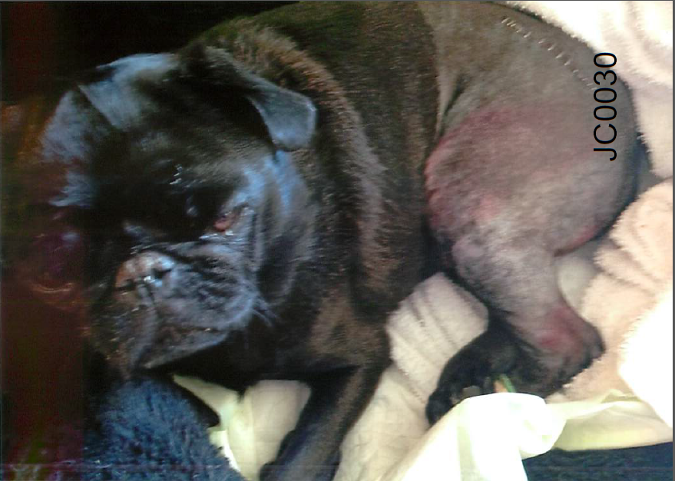
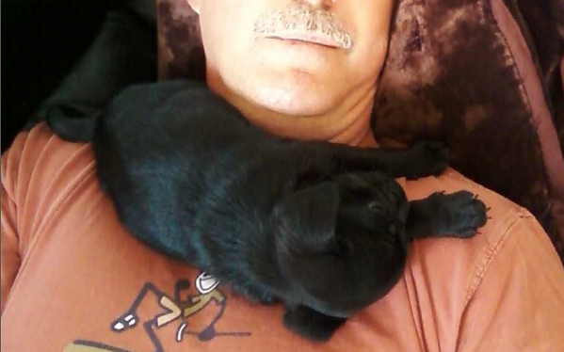
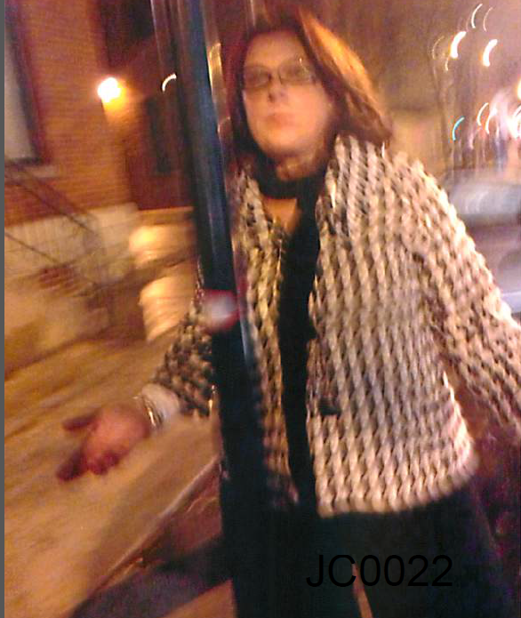
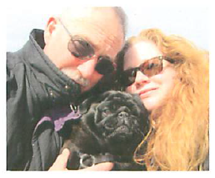
Negligent Acts Harming/Killing Animals
Example – Crowley, 15-M1-300576
  Dog Jezebel, guardians/owners James & Mary Crowley, driver MaryPat McAuliff
  Jezebel – 3 yr. 10 mo., spayed female dog
  November 29, 2014, James Crowley was walking Jezebel (on leash) north on Clark Street (Chicago) with walk signal while crossing Superior Street
  MaryPat McAuliff turned her car into intersection and ran over Jezebel with her car, nearly hitting James Crowley as well.
  Jezebel’s pelvis was crushed in three places, her right hip luxated, her right femoral head broken and part of her hip was removed. Jezebel’s tail was also broken at the base and further surgeries were necessary. A few days later, Jezebel died from her injuries.

Slide 34
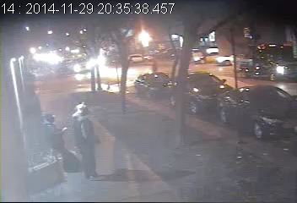
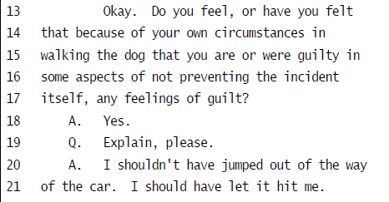
Negligent Acts Harming/Killing Animals
Example – Crowley
Claims
  Negligence
  Negligent Infliction of Emotional Distress
Outcome
  Settlement ($20,000)
Important Considerations
  Genuine Sentiment
  Video of Events

Slide 35
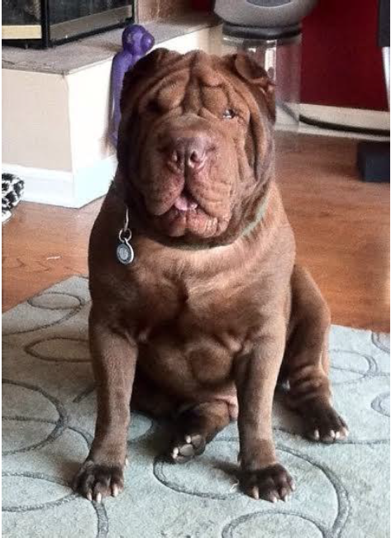
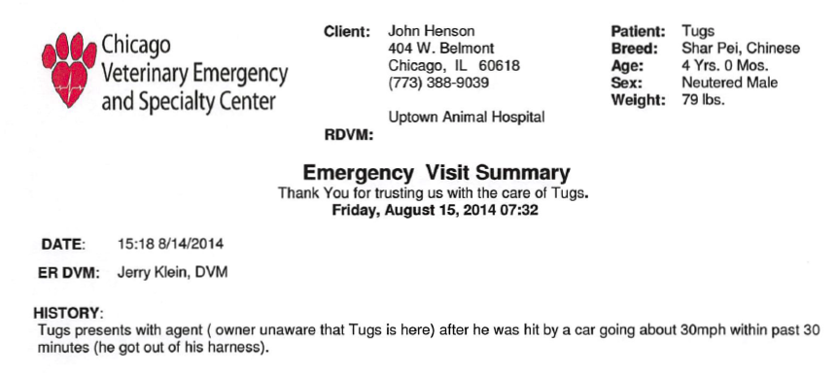
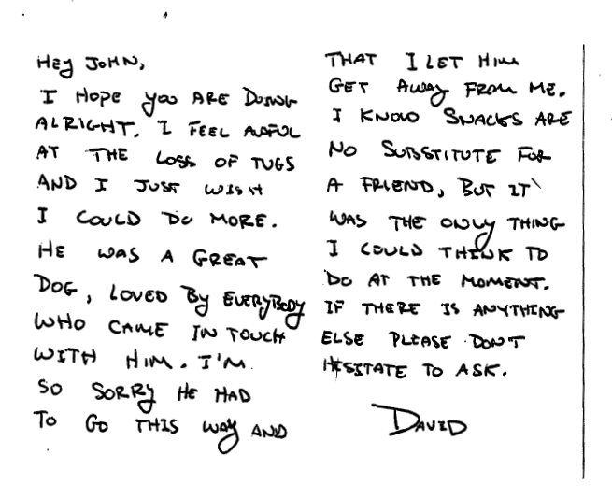
Negligent Acts Harming/Killing Animals
Example – Henson, 15-M1-10965
The dog Tugs, owner/guardian John Henson, dog walker David Drake (Millennium Dog Walkers)
Tugs was a 6 year old, Chinese Shar-Pei, companion canine and part-time therapy dog in Mr. Henson’s private psychotherapy practice
On August 14, 2014, David Drake let Tugs get away from him on walk, Tugs was struck by a vehicle and died shorly thereafter at the emergency vet.

Slide 36
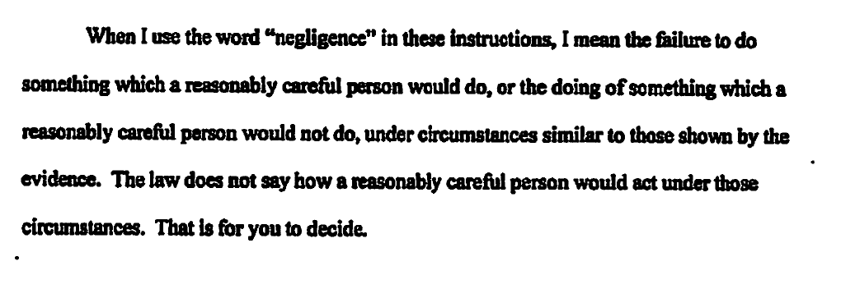
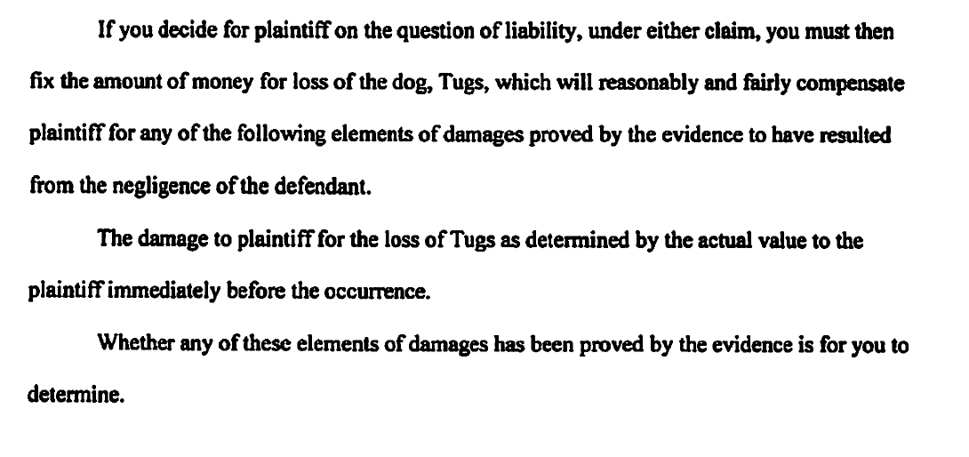
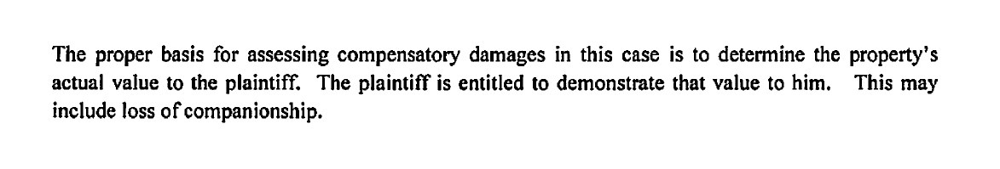
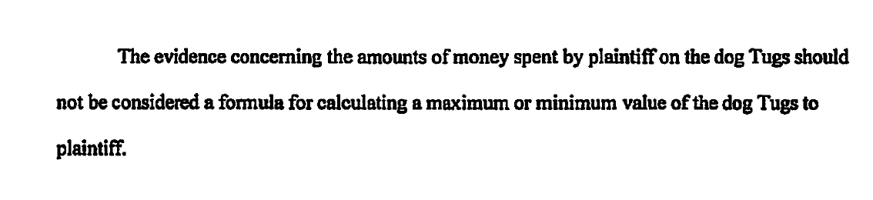
Negligent Acts Harming/Killing Animals
Example – Henson
Claims:
  Breach of Agreement (Special Care)
  Negligence
  Respondeat Superior
Outcome
  Jury Verdict ($8,500) for Breach of Agreement

Slide 37
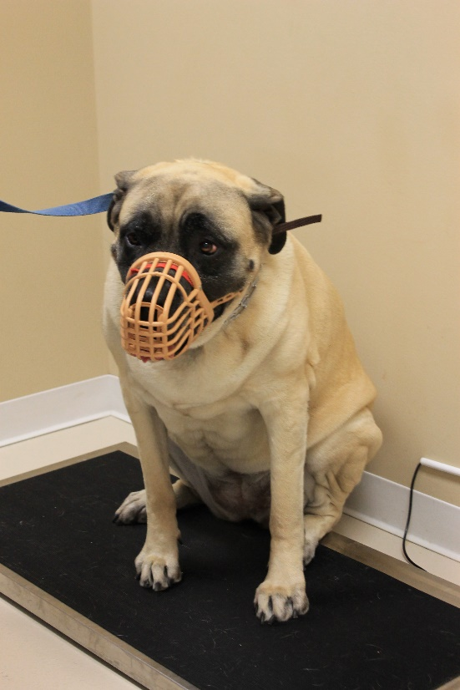
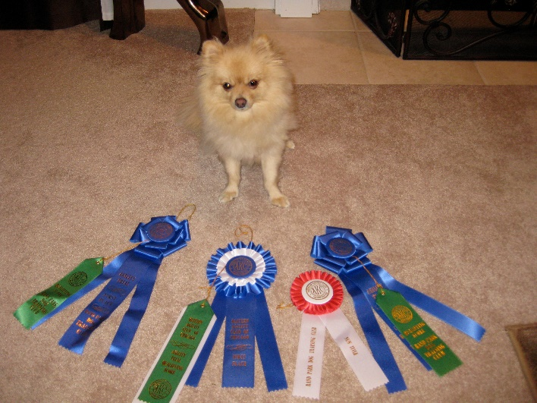
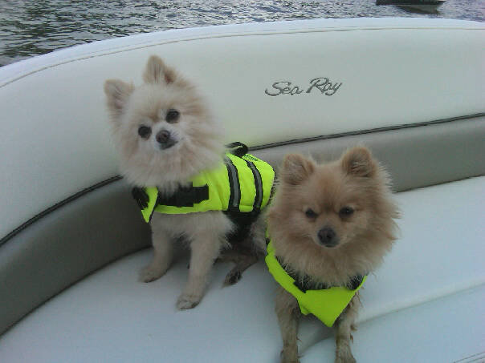




Negligent Acts Harming/Killing Animals
Example – Mengarelli, 11-L -47
The dog Dolce, guardians/owners Mike and Heather Mengarelli, dog owner Angela Marquardt, & business Orchard Road Animal Hospital (ORAH)
Dolce was a 3 year old Pomeranian rescue dog who competed with Heather in shows/events
In the afternoon of December 5, 2010, Mike & Heather brought their two dogs, Dolce and Lindsay to ORAH to get a picture taken with Santa Paws
Upon passing through the first set of doors and entering the corridor with Dolce (leashed) and Lindsay (held by Mike), a large mastiff barreled through the lobby doors and into the corridor, trapping Heather and Dolce
The large mastiff lunged at and grasped Dolce, ripping Dolce’s leash from Heather’s hand, violently thrashed Dolce (despite Mike’s efforts to free Dolce & while Marquardt did nothing), Dolce fell to the ground and shortly thereafter died from the attack (despite some veterinary efforts to save Dolce)

Slide 38


Negligent Acts Harming/Killing Animals
Example – Mengarelli
Claims:
  Negligence (ORAH)
  Premises Liability Act (ORAH)
  Negligence (Marquardt)
  NIED (ORAH & Marquardt)
  Animal Control Act (Marquardt)
Outcome
  Settlement ($19,000)

Slide 39

Negligent Acts Harming/Killing Animals
Example – Anzalone v. Kragness (1st Dist 2005)
  Suit brought for $100,000 for negligent loss of cat during boarding (bailment case)
  Cannot dismiss for high demand alone – “actual value” standard
  Dicta
“Actual Value”
  No emotional distress … BUT
Jankoski v. Presier Animal Hospital, Ltd. (1st Dist. 1987)
  Sued for “Loss of Companionship” as Independent Cause of Action
  Not Allowed As Independent Cause – But “Actual Value” May Include Some Element of Sentimental Value

Slide 40

Negligent Acts Harming/Killing Animals
Example – Anzalone v. Kragness
  Jury Instruction – after REMAND

Slide 41

Negligent Acts Harming/Killing Animals
Leith v. Frost (4th Dist. 2009)

Slide 42



Motions
Motions to Dismiss
  Pleadings (Failure to State Cause of Action)
  Merits/Proofs (Summary Judgment, etc.)
Motions in Limine
  Evidence Allowed
    Photos
    Testimony (Distress, etc.)
    Prior Bad Acts
  Damages Available
    Market v. Actual Valuation

Slide 43

Jury Considerations
Voir Dire
  If Allowed, Ask Open Ended Questions
Strikes
  Use Cautiously & Carefully
Jury Instructions
  May Not Be Pattern
Notes:
READ – Jerry Spence

Slide 44

Settlements
Things to Consider:
For Business or Professional Defendant
  Confidentiality
  Sometimes Non-Disparagement
**Use Caution if Settlement Seeks
Non-Disparagement by Attorney
– CHECK ETHICS RULES.**

Slide 45

Questions?
Thank You!

