Slide 1
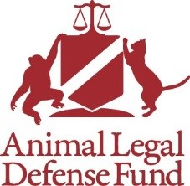
Applying ESA Protections to Captive Animals
KUEHL V. SELLNER, 161 F. Supp. 3d 678 (N.D. Iowa 2016)
Blue River Law, P.C.

Slide 2
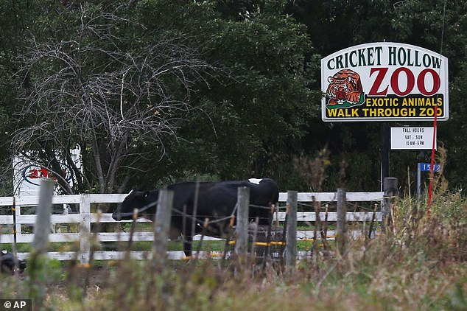

Slide 3
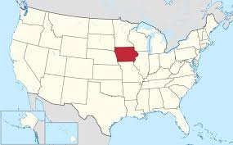
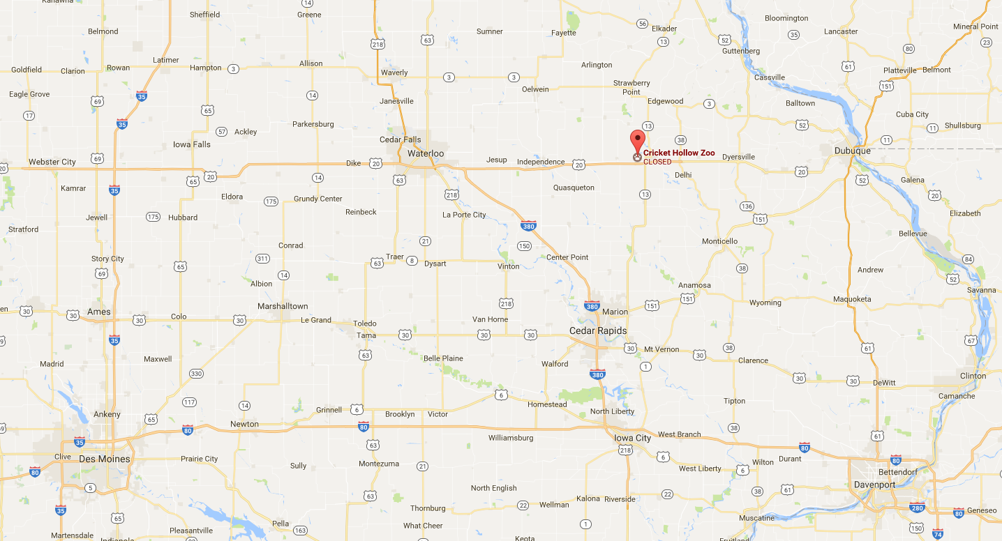
Manchester, Iowa

Slide 4
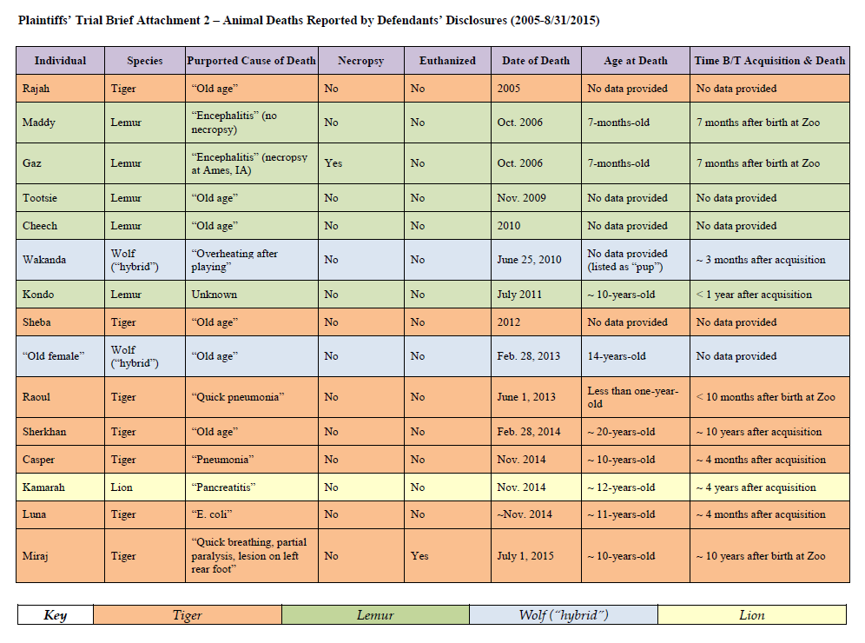

Slide 5
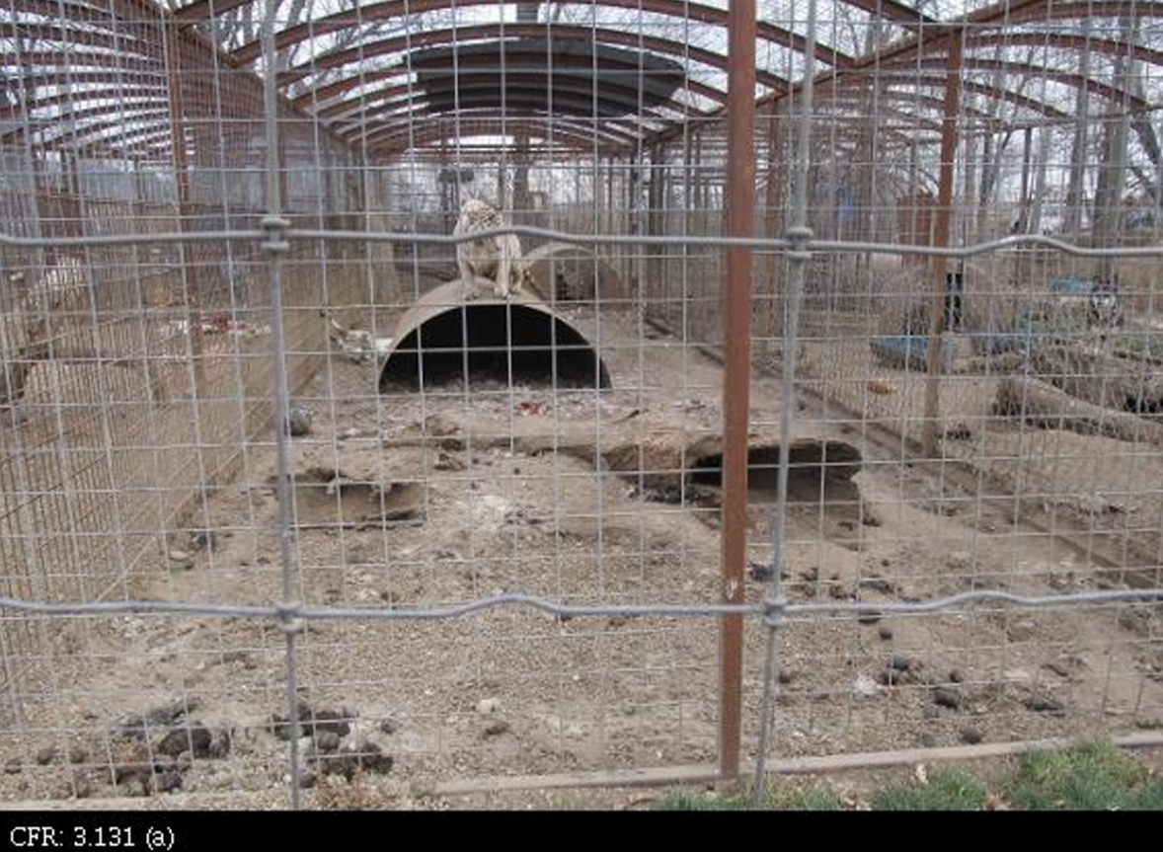

Slide 6
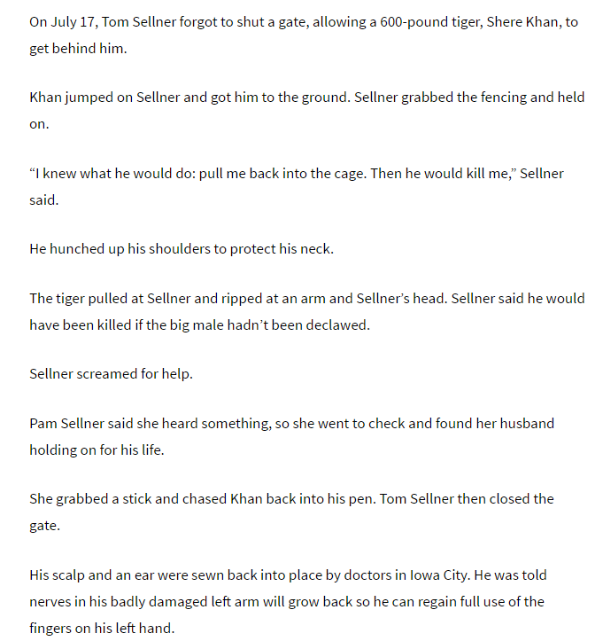
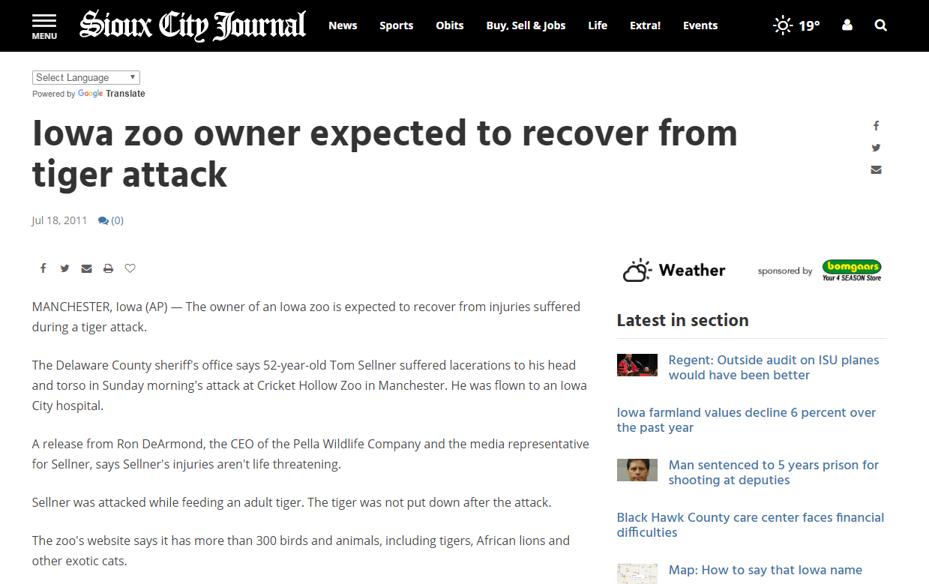

Slide 7
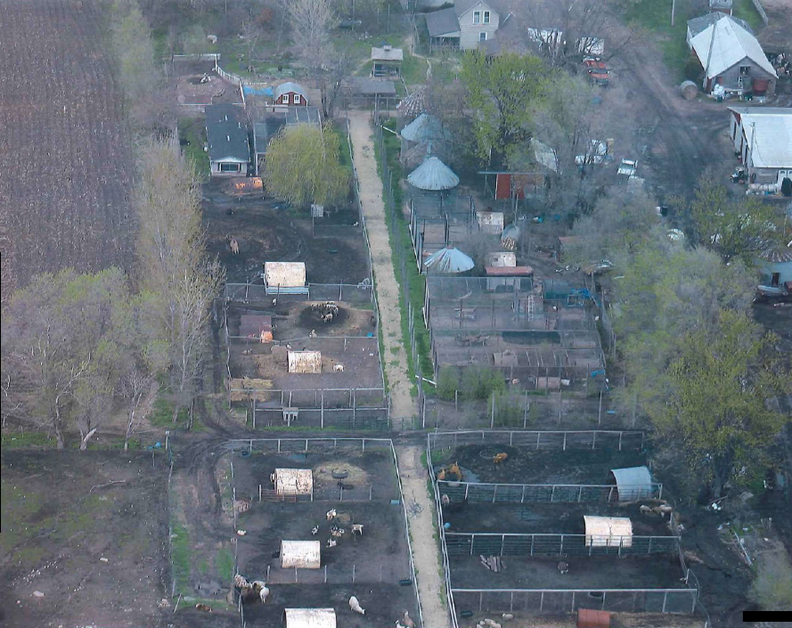
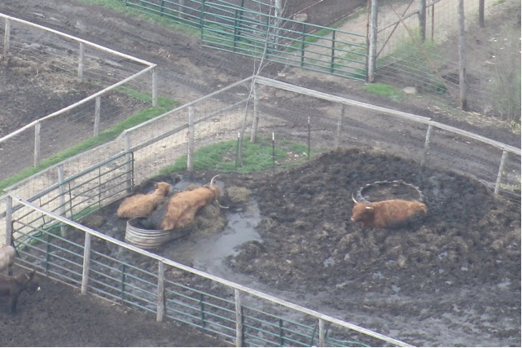

Slide 8
ESA Section 11, 16 U.S.C. § 1540
(g) Citizen suits
(1) Except as provided in paragraph (2) of this
subsection any person may commence a civil
suit on his own behalf—
(A) to enjoin any person, including the
United States and any other governmental instrumentality or agency (to the extent permitted
by the eleventh amendment to the
Constitution), who is alleged to be in violation
of any provision of this chapter or regulation
issued under the authority thereof

Slide 9
ESA Section 9, 16 U.S.C. § 1538
. . . it is unlawful for any person . . . to-- . . .
  (B) take any such species within the United States . . .
  (D) possess, sell, deliver, carry transport, or ship, by any means whatsoever, any such species taken in violation of subparagraph (B) . . .
  (E) deliver, receive, carry transport, or ship in interstate or foreign commerce, by any means whatsoever and in the course of a commercial activity, any such species . . .

Slide 10
ESA, 16 U.S.C. § 1532(19)
The term “take” means to harass, harm, pursue, hunt, shoot, wound, kill, trap, capture, or collect, or to attempt to engage in any such conduct.

Slide 11
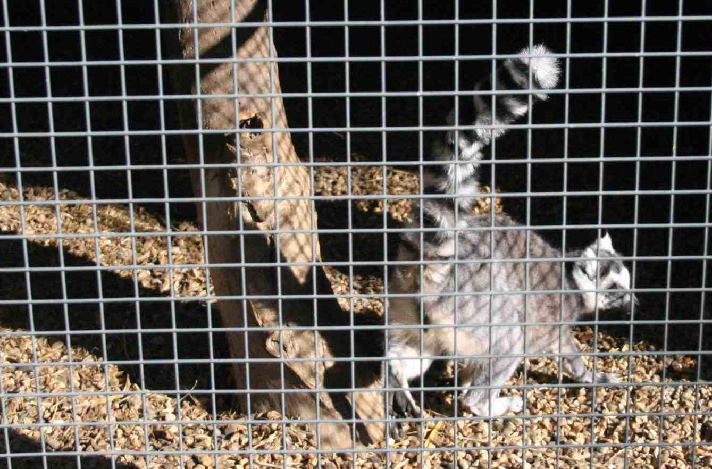
50 CFR § 17.3
Harass means an intentional or negligent act or omission
which creates the likelihood of injury to wildlife
by annoying it to such an extent as to significantly disrupt normal behavioral patters which include, but are not limited to, breeding, feeding, or sheltering.
This definition when applied to captive wildlife, does not include generally accepted: (1) Animal husbandry practices that meet or exceed the minimum standards for facilities and care under the Animal Welfare Act, . . .

Slide 12
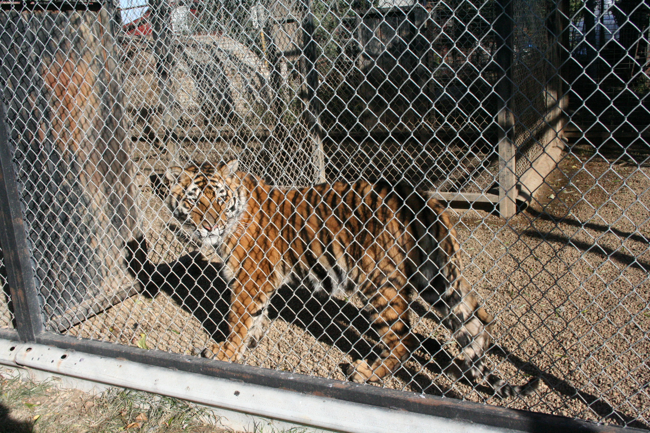
50 CFR § 17.3
Harm in the definition of “take” . . . means an act
which actually kills or injures wildlife.
Such an act may include significant habitat modification or degradation where it actually kills or injures wildlife by significantly impairing essential behavioral patterns, including breeding, feeding or sheltering.

Slide 13
USFWS on application to captive wildlife
“Captive members have the same legal status as the species as a whole.” 79 Fed. Reg. 37578, 37597 (July 1, 2014)
“On its face the ESA does not treat captives differently. . . Section 9[] of the ESA [prohibiting take] applies to endangered species regardless of their captive status.” 80 Fed. Reg. 7380, 7399 (Feb. 10, 2015)

Slide 14
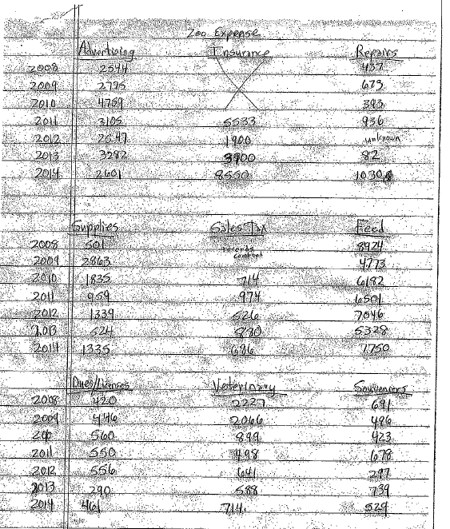
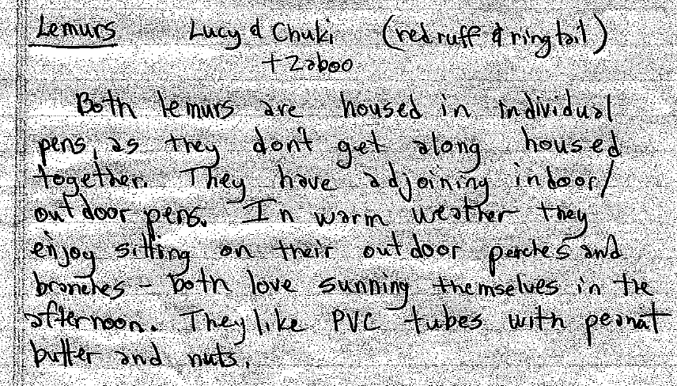

Slide 15
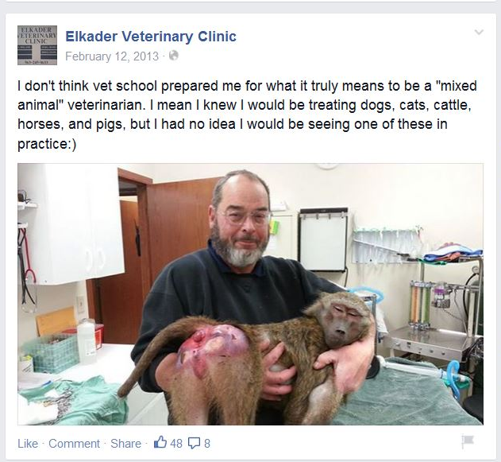

Slide 16
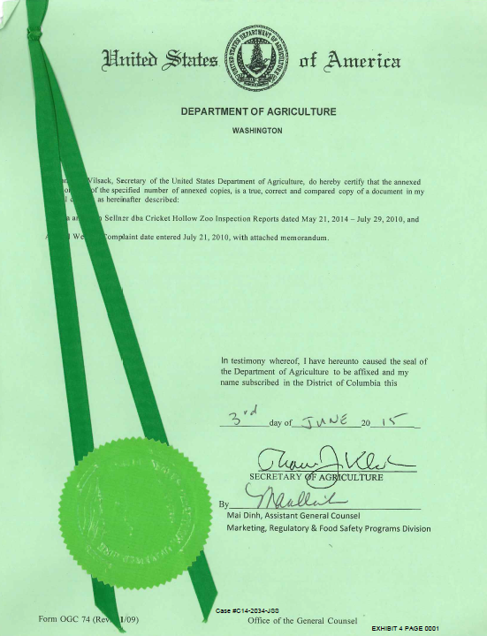
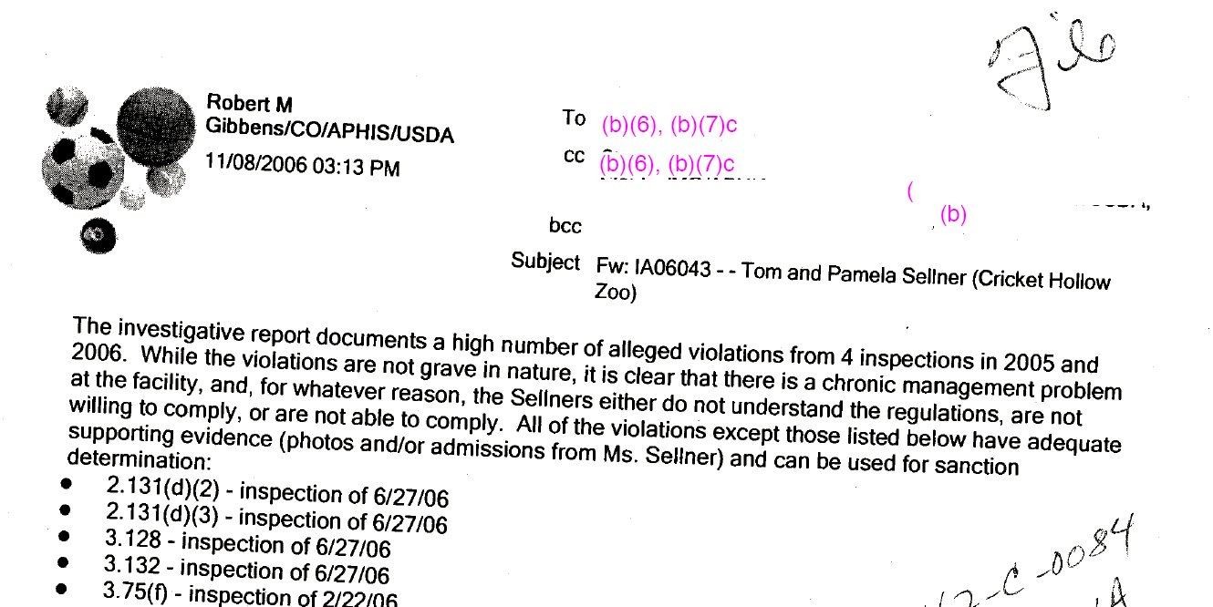

Slide 17
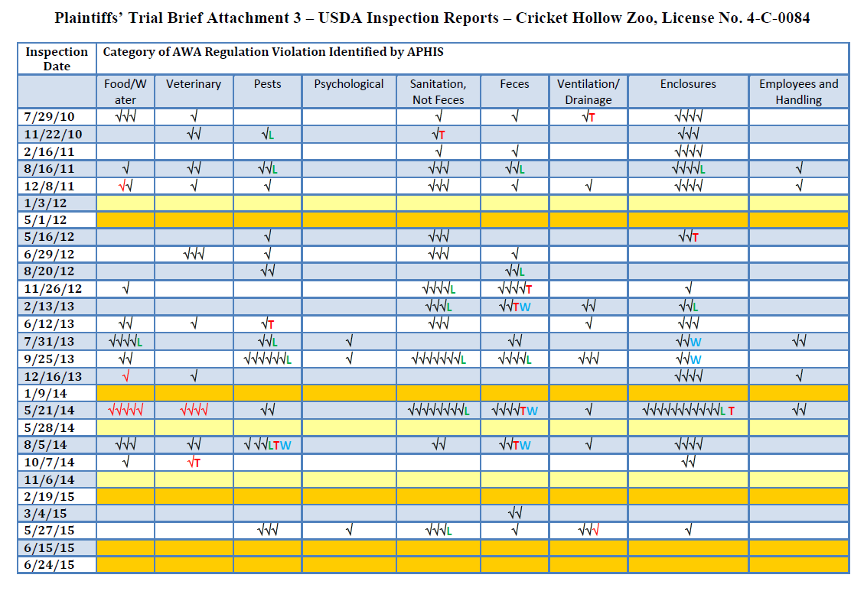
Notes:
USDA AWA Enforcement History:
November 2006: Dr. Robbert Gibbens says, “it is clear that there is a chronic management problem at the facility, and, for whatever reason, the Sellners either do not understand the regulations, are not willing to comply, or are not able to comply.”
December 2006: Settlement Agreement for $4,035
October 2012: USDA Investigation
February 2013: Settlement Agreement for $6,857
June 2015: 21-day License Suspension
July 2015: USDA files complaint with Administrative Law Judge, beginning process for license revocation

Slide 18
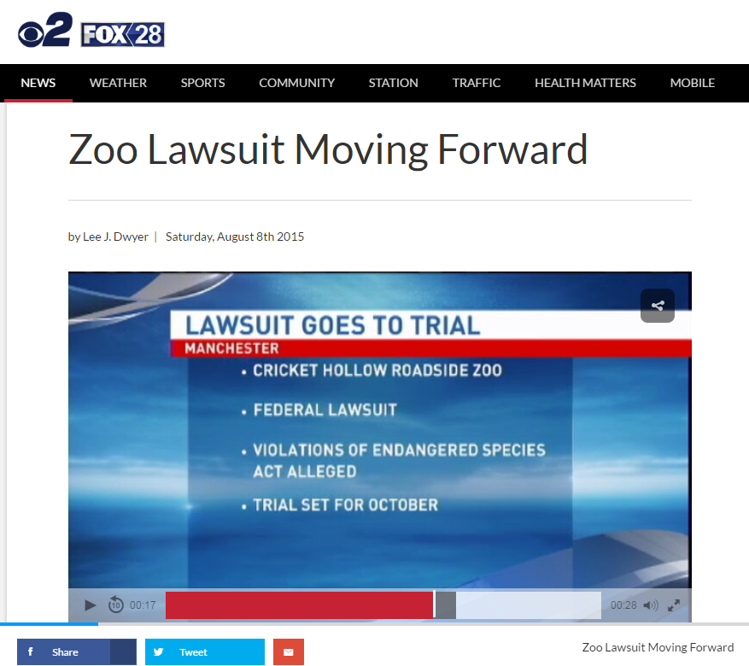

Slide 19
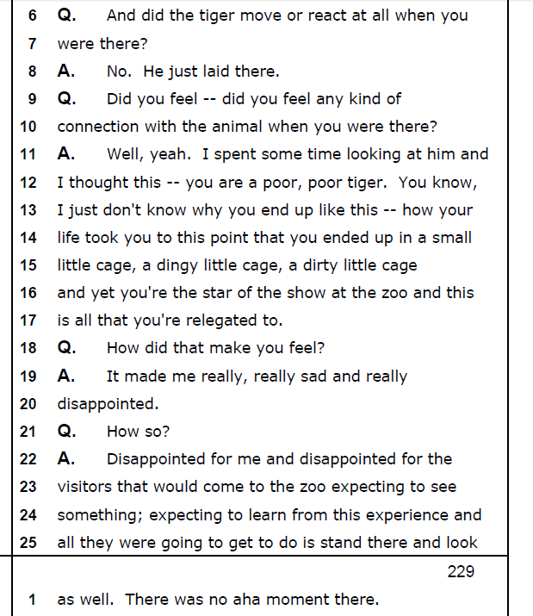
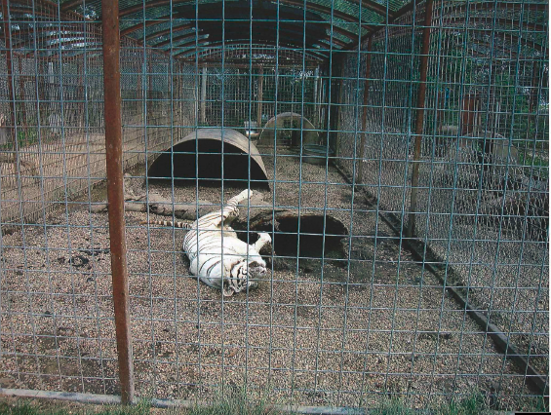
Tracey Kuehl

Slide 20
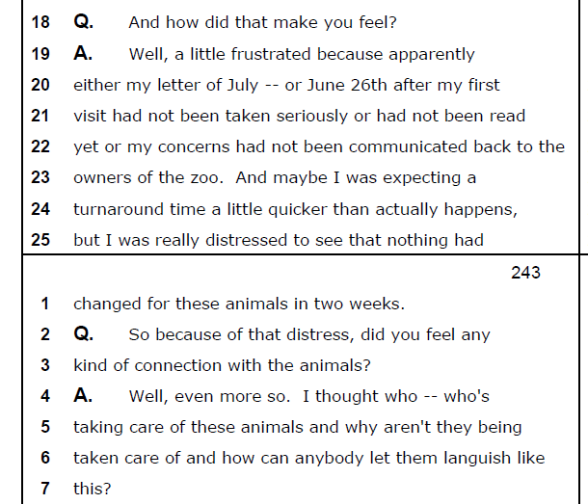
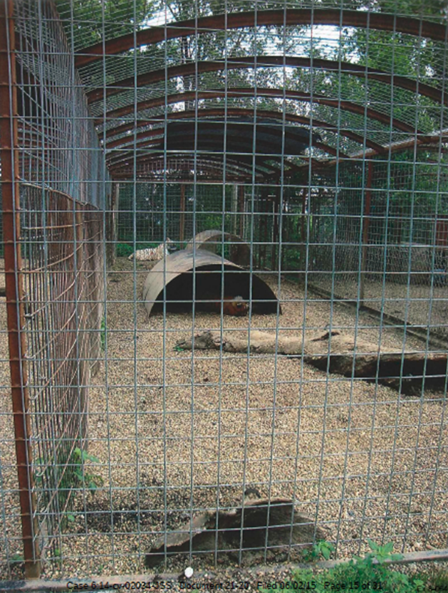
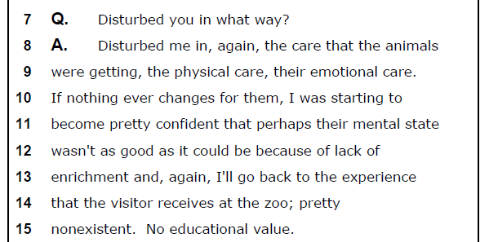
Tracey Kuehl

Slide 21
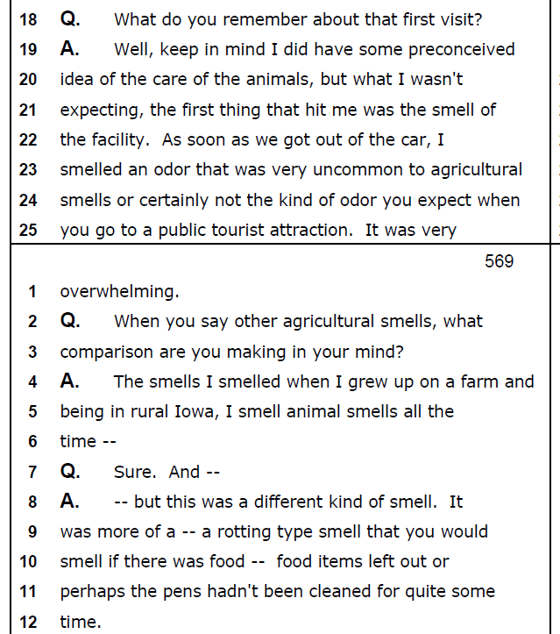
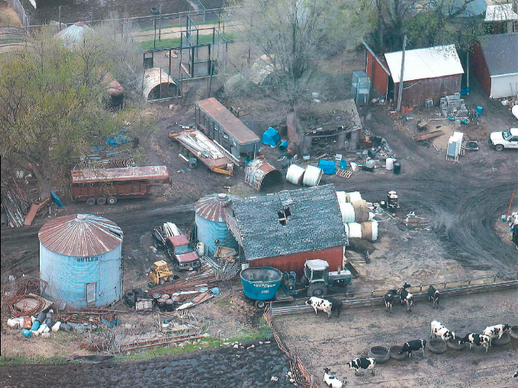
Lisa Kuehl

Slide 22
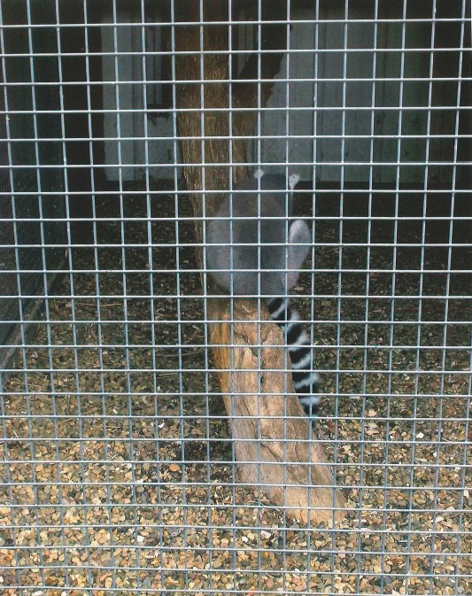
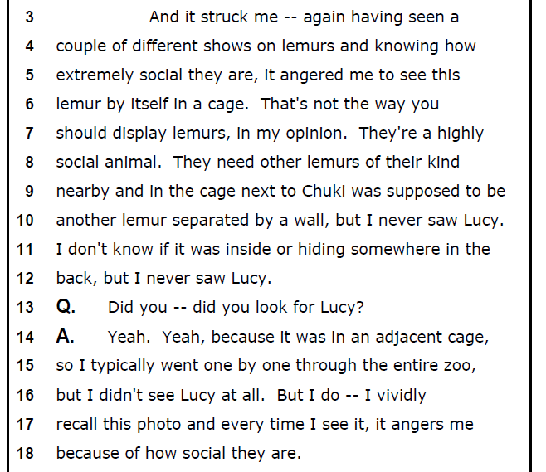
John Braumann

Slide 23
50 CFR § 17.3
Harass means an intentional or negligent act or omission
which creates the likelihood of injury to wildlife
by annoying it to such an extent as to significantly disrupt normal behavioral patters which include, but are not limited to, breeding, feeding, or sheltering.
This definition when applied to captive wildlife, does not include generally accepted: (1) Animal husbandry practices that meet or exceed the minimum standards for facilities and care under the Animal Welfare Act, . . .

Slide 24
Notes:
USDA AWA Enforcement History:
November 2006: Dr. Robbert Gibbens says, “it is clear that there is a chronic management problem at the facility, and, for whatever reason, the Sellners either do not understand the regulations, are not willing to comply, or are not able to comply.”
December 2006: Settlement Agreement for $4,035
October 2012: USDA Investigation
February 2013: Settlement Agreement for $6,857
June 2015: 21-day License Suspension
July 2015: USDA files complaint with Administrative Law Judge, beginning process for license revocation

Slide 25
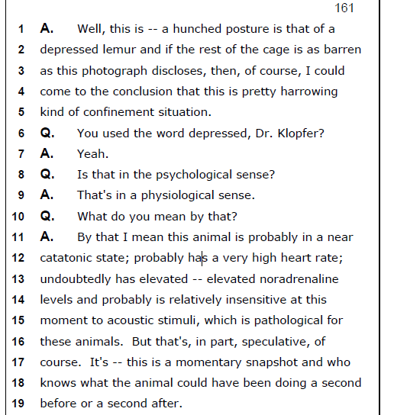
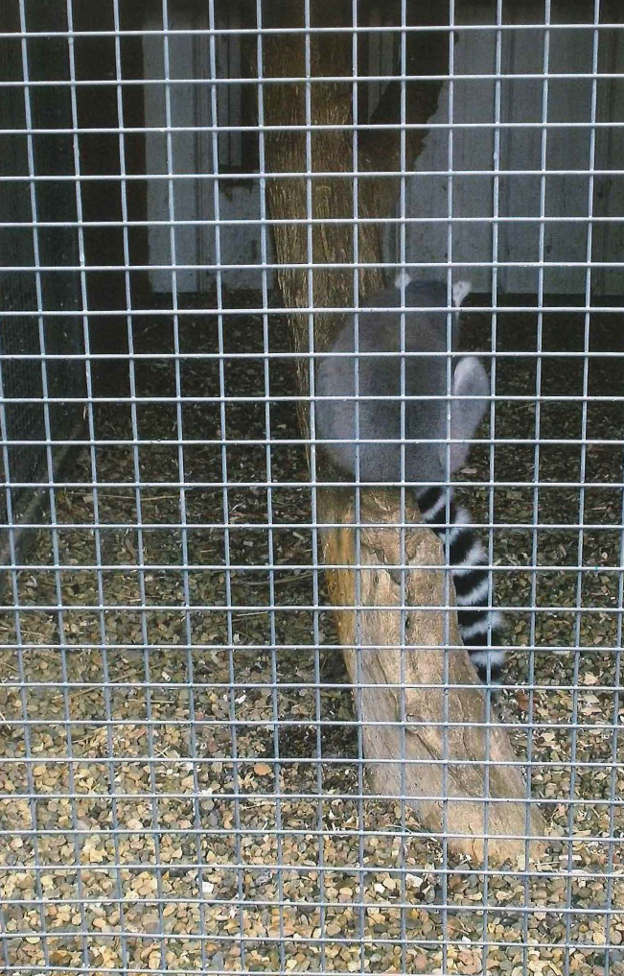
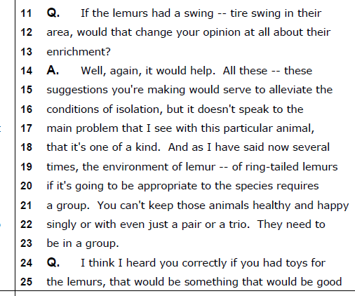
Dr. Klopfer on Lemur Isolation

Slide 26
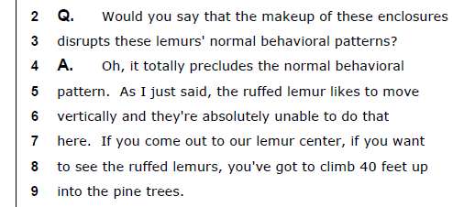
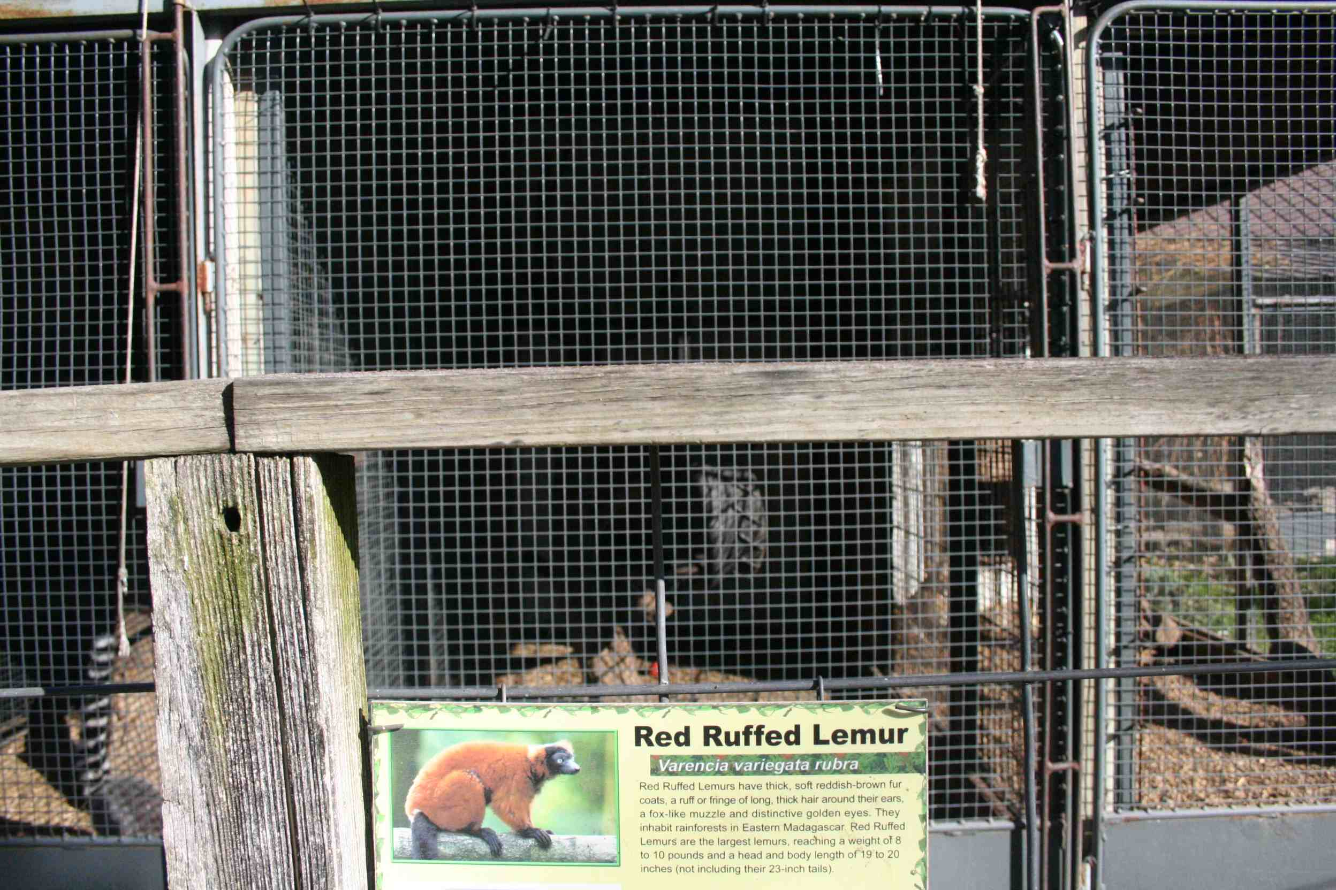
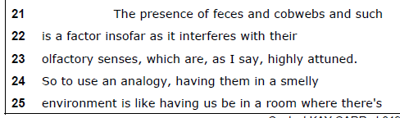
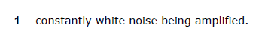
Dr. Klopfer on Lemur Enclosures, Sanitation

Slide 27
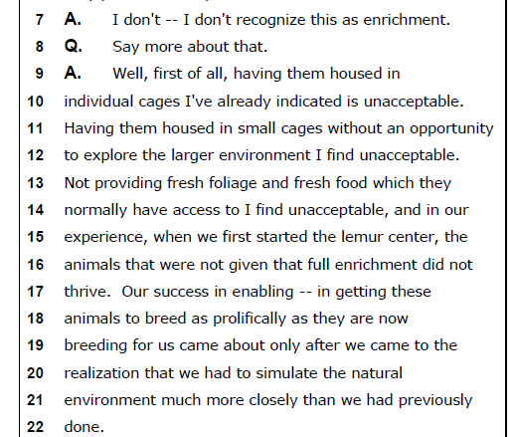
Dr. Klopfer on Lemur Enrichment

Slide 28
Judgment: Lemur Harassment
“Housing the lemurs in relative isolation is not consistent with their social needs and significantly disrupts their normal behavioral patterns.”
Environmental Enrichment
Inadequate Sanitation

Slide 29
50 CFR § 17.3
Harm in the definition of “take” . . . means an act
which actually kills or injures wildlife.
Such an act may include significant habitat modification or degradation where it actually kills or injures wildlife by significantly impairing essential behavioral patterns, including breeding, feeding or sheltering.

Slide 30
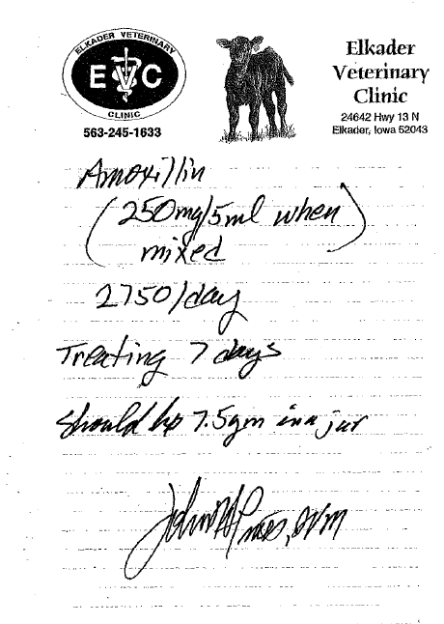
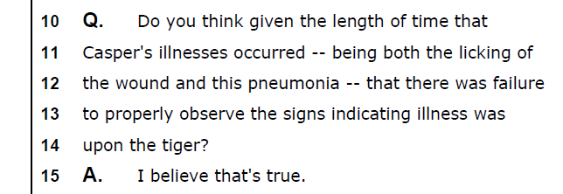
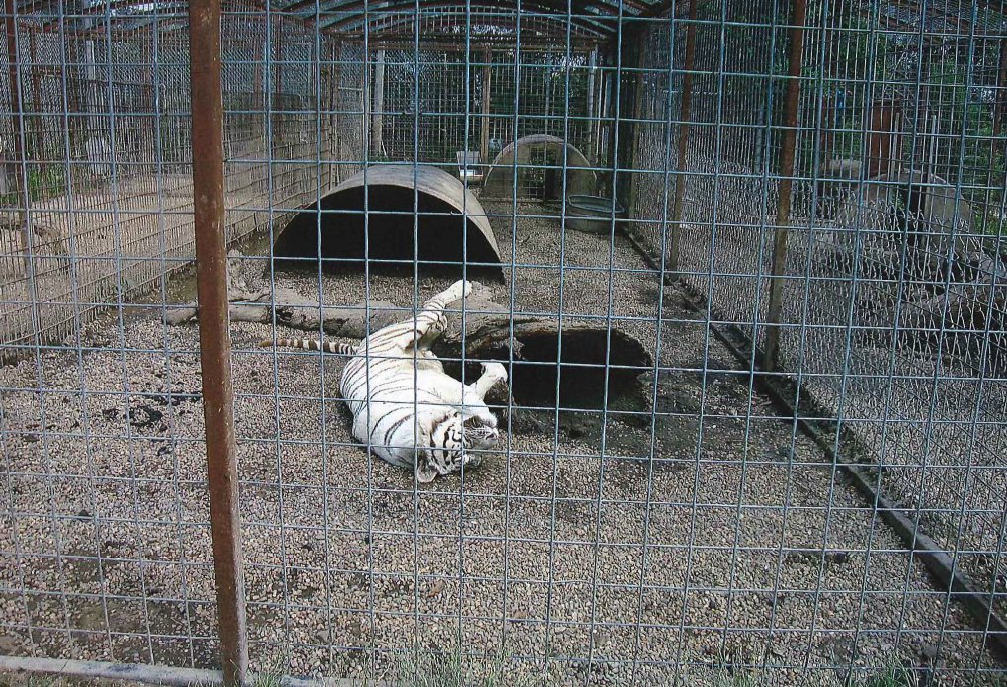
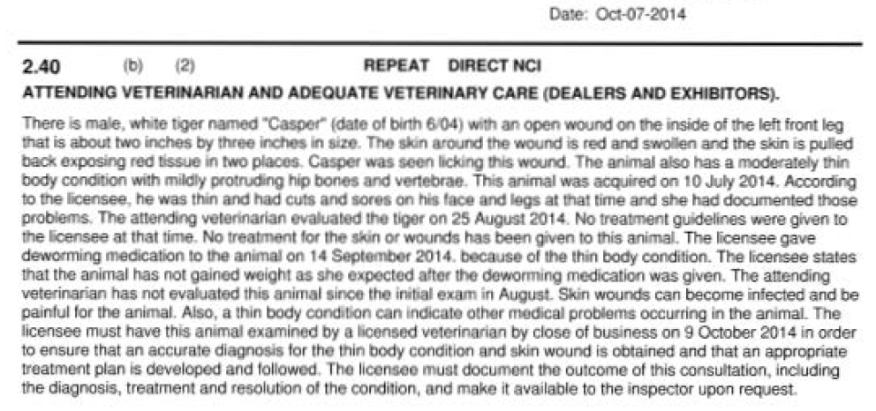
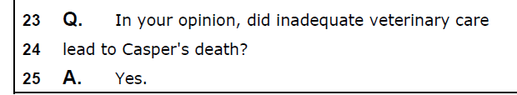
Tiger Veterinary Care - Casper

Slide 31
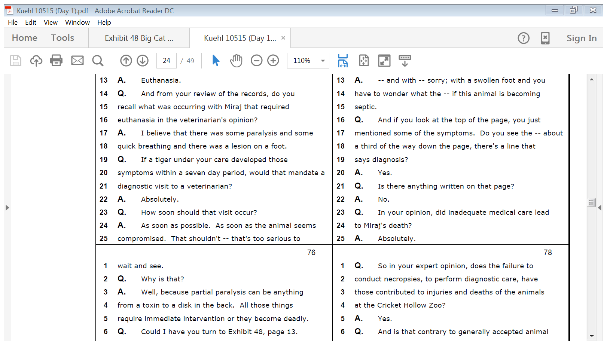
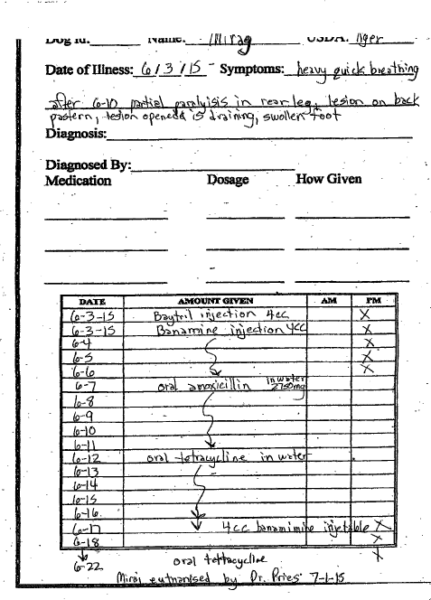
Dr. Conrad on Veterinary Care – Miraj

Slide 33
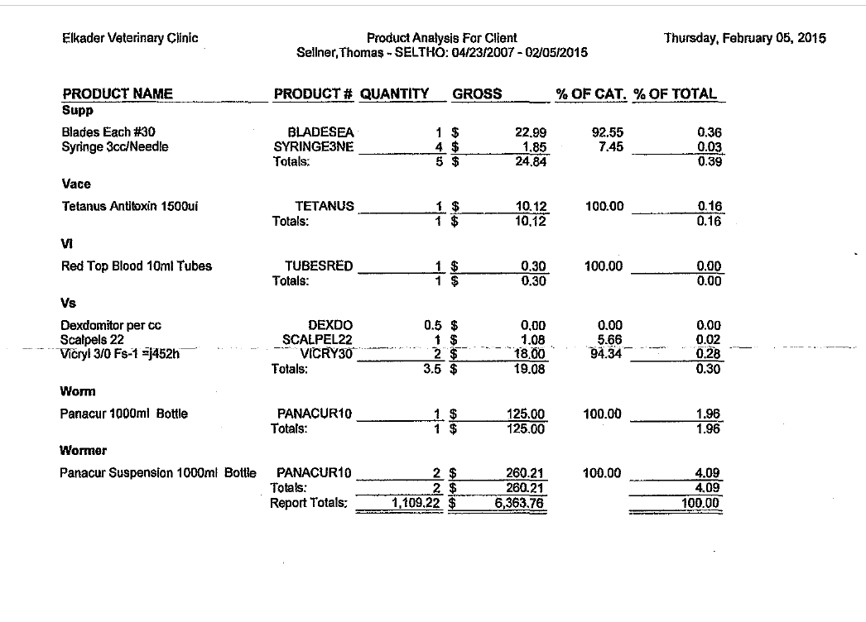
Total Veterinary Costs: 2005-2015

Slide 34
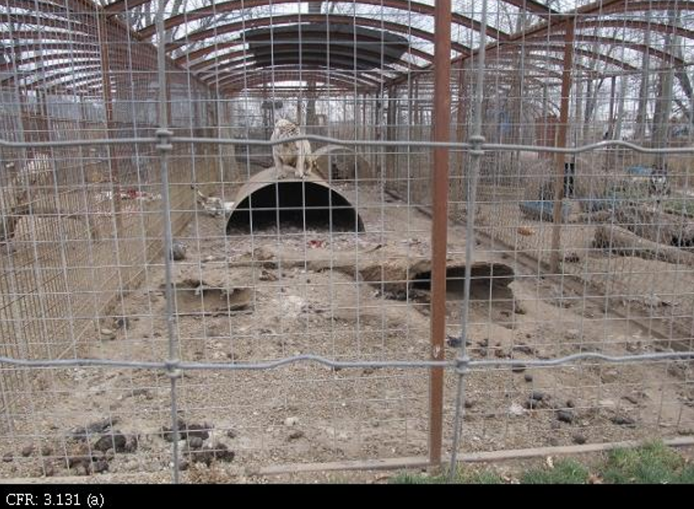
USDA on Sanitation

Slide 35
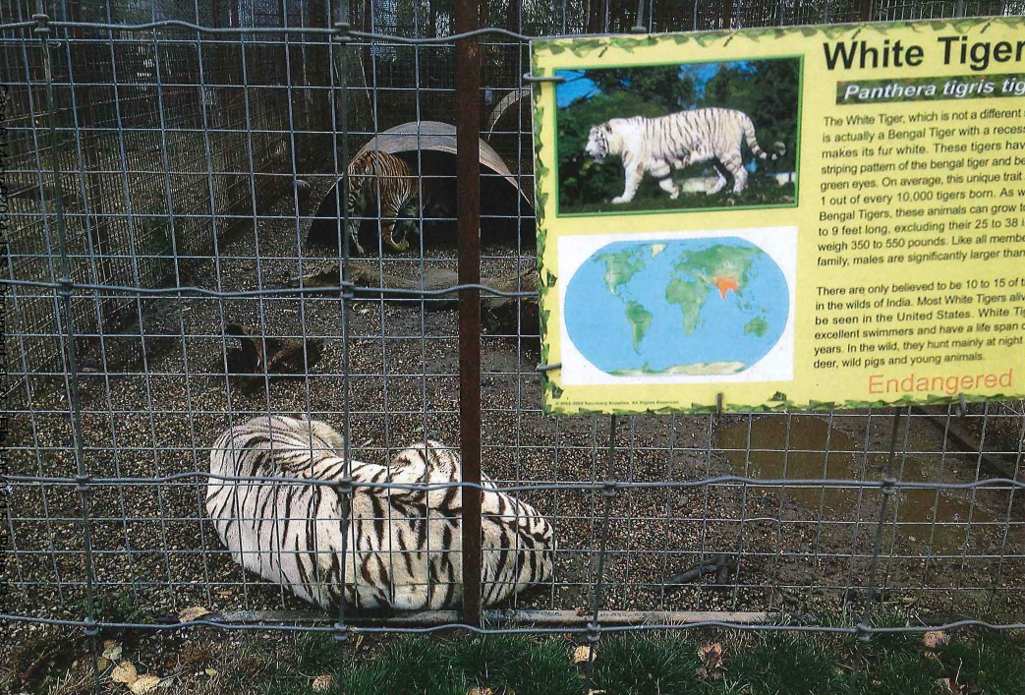
Judgment—Tiger Harm/Harassment
Harm – Inadequate Veterinary Care
Harassment – Inadequate Sanitation

Slide 36
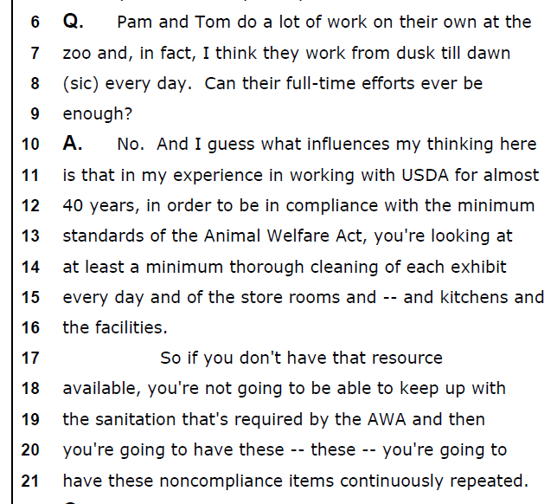
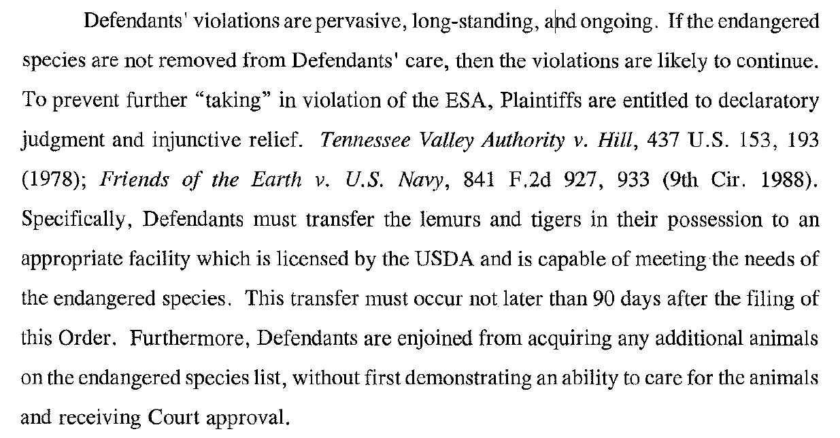
Remedy

Slide 37
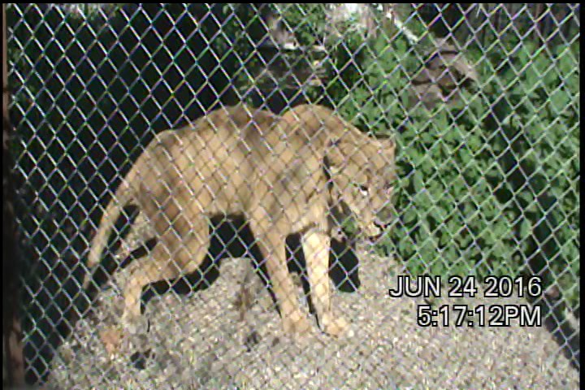
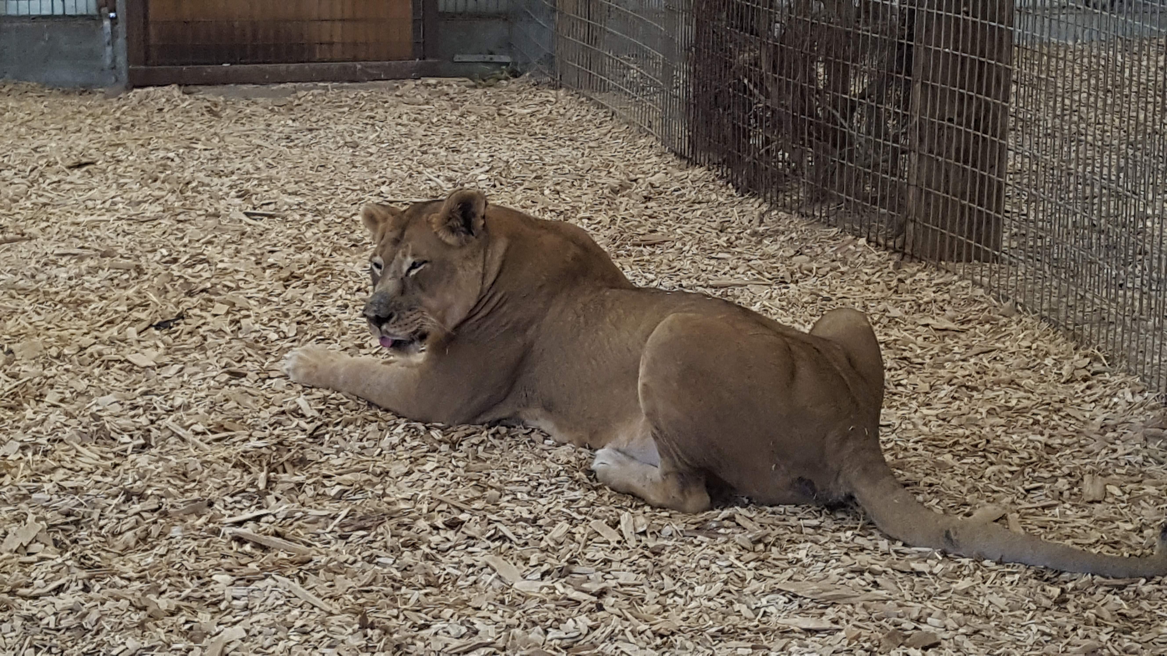
Epilogue

Slide 38
Contact
Jeff Pierce
Legislative Counsel
Animal Legal Defense Fund
525 East Cotati Avenue
Cotati, California 94931
jpierce@aldf.org
(707) 795-2533 ext. 1038

