Slide 1
2016 Developments in Louisiana Animal Law

Slide 2
2016 cases
ANIMAL BITES
(Everybody Bites Sometimes)

Slide 3
LA C.C. ART. 2321
Owner of an Animal is answerable for damage caused by the animal
However, he is answerable for the damage only upon a showing that he knew or in the exercise of reasonable care, should have known that his animal’s behavior would cause damage; that the damage could have been prevented by reasonable care, and that he failed to exercise such reasonable care
Nonetheless, a dog owner is strictly liable for damages for injuries to persons or property caused by the dog which the owner could have prevented and which did not result from the injured person’s provocation of the dog

Slide 4
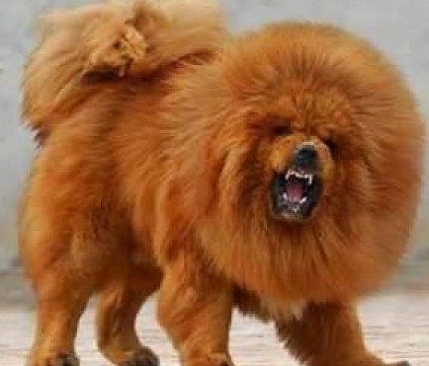
Dog Bites

Slide 5
Frazier v. Difulco, 188 So.3d 115 (La.app. 3 Cir. 02/17/16) (unpublished opinion)
Facts: π was meter reader in Alexandria who was bitten by ∆’s dog
        Uncontested Facts: ∆’s dog bit π
        π entered ∆’s yard
        Dog had no bite history
        π did nothing to provoke the dog

Slide 6
3rd Circuit affirmed the trial court’s dismissal of π’s case
  Cited to Art. 2321and Pepper v. Triplet, 864 So.2d 181 (La. 01/21/04). Art. 2321 imparts strict liability on the dog owner, but Pepper held that in order to prove that the dog owner could have prevented the injuries caused by the dog, the Plaintiff must show that the dog presented an unreasonable risk of harm.
  Trial Court believed the ∆’s version of events over the π’s version, and that the Plaintiff did not show that the dog’s owner could not have prevented the injuries caused by the dog.

Slide 7
Despite the strict liability for dog owners that is established by Art. 2321, the Frazier court focused solely on the issue of the owner’s inability to prevent the injuries caused by the dog.
Compare this to…

Slide 8
Coburn v. Dixon 2016 La. App. Lexis 815;
15-1095 (La. App. 3 cir 04/27/16)
Ms. Coburn got bitten by Ms. Dixon’s dog (her neighbor)
She sued everybody: Ms. Dixon, Ms. Dixon’s landlord; Ms. Dixon’s landlord’s insurance co.
Really great discussion regarding what the dog bite victim would have to prove at trial in order to prevail against the parties

Slide 9
Coburn court held that: in order for the plaintiff to establish a claim in strict liability, he/she must show that the dog posed an unreasonable risk of harm.
If so, the owner will be presumed to be at fault because he failed to prevent an ijury unless he can show that the injury was due solely to the fault of a third party or as a result of the injured person’s provocation
Here the landlord and insurance company won summary judgement because Ms. Coburn was unable to prove that either party knew of the existence of the dog and that the dog had dangerous propensities

Slide 10
Specifically, under Art. 2321 and Triplet, Ms. Coburn would have to prove that the dog presented an unreasonable risk of harm and that the defendants knew about the dog and its dangerous propensities

Slide 11
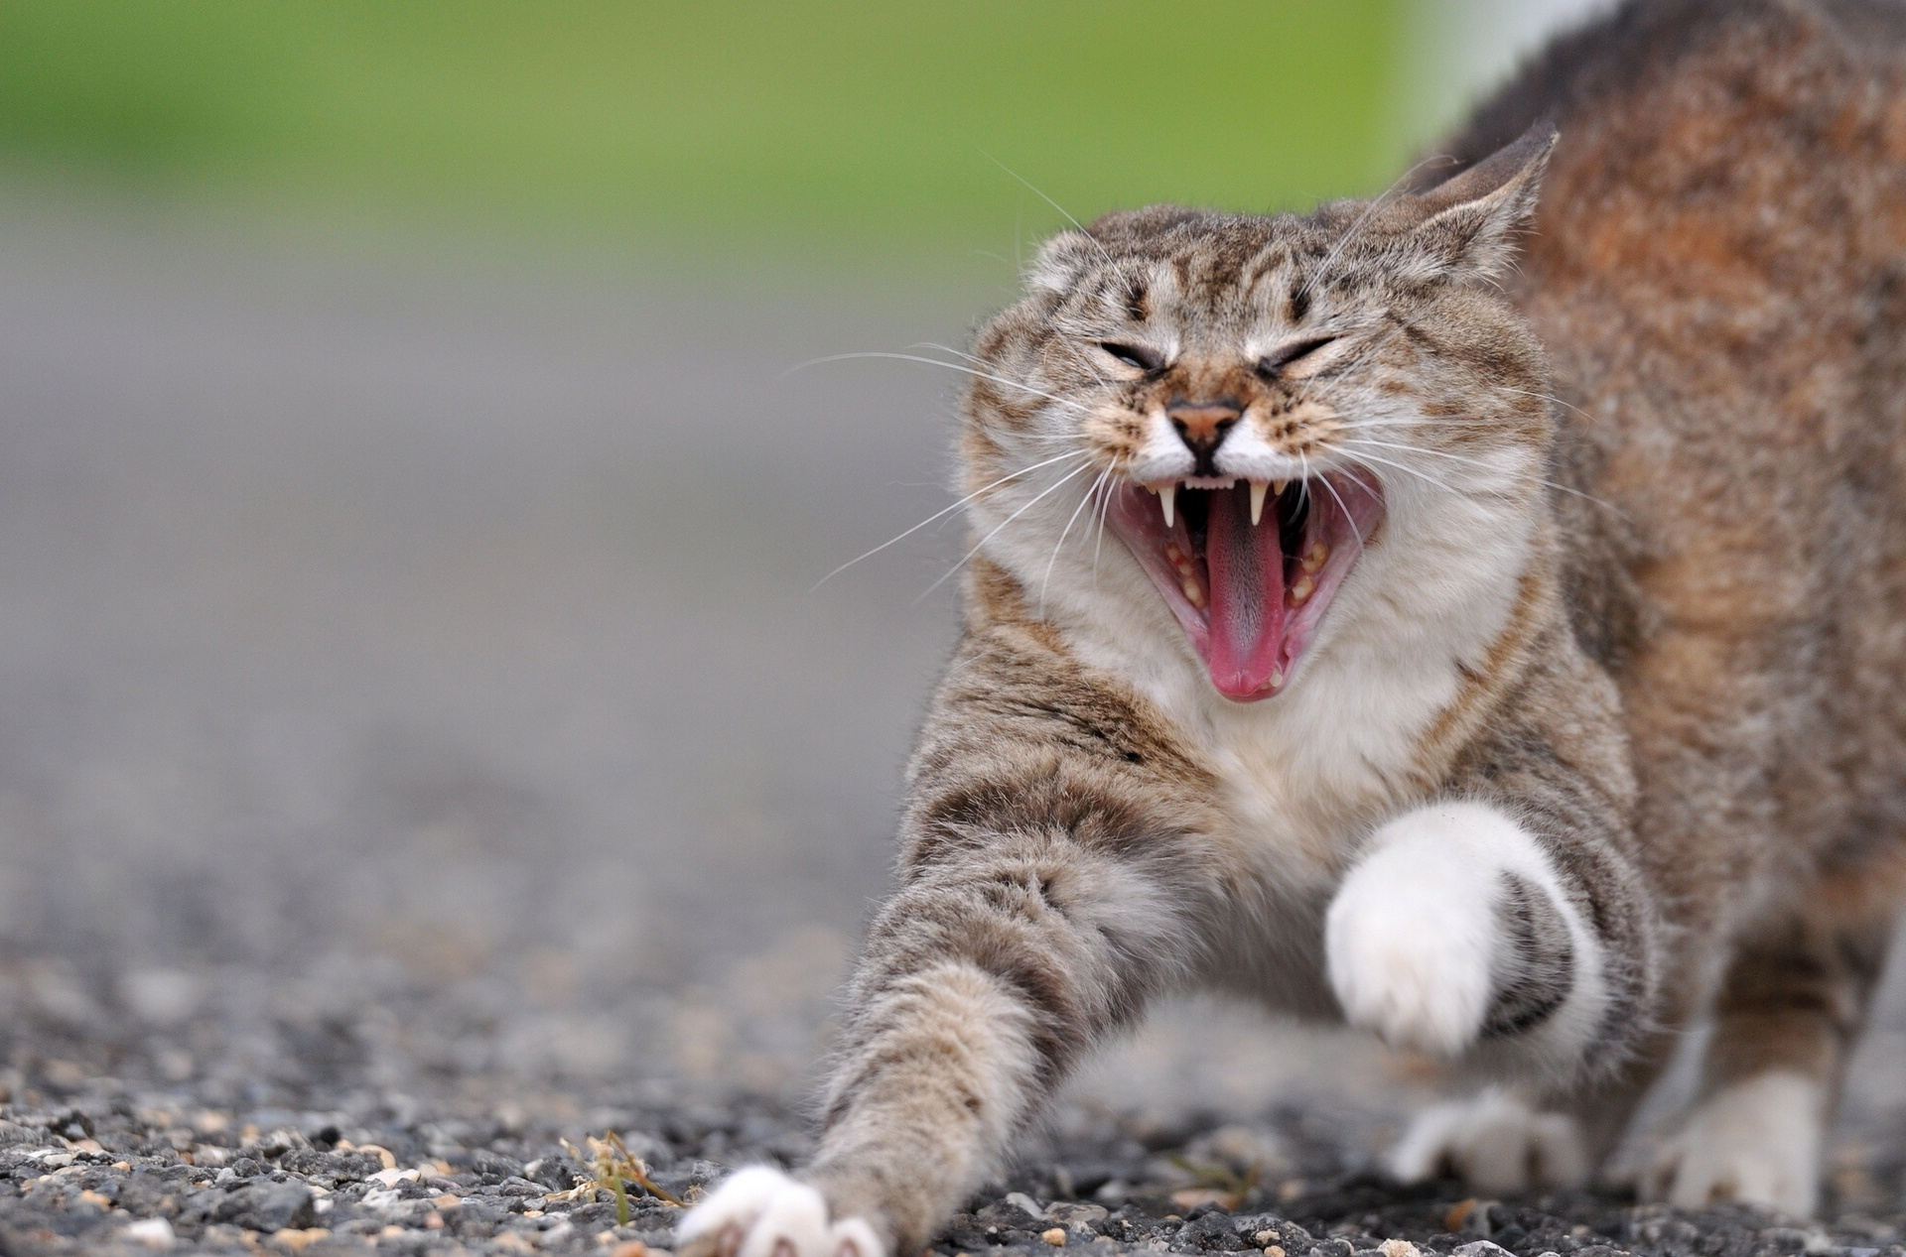
Cat Bites

Slide 12
Ducote v. boleware, 2016 La. App. Lexis 262 2015-0764 (la. App. 4 cir 02/17/16)
FACTS
  Ms. Ducote went for a stroll one evening
  Her neighbors, the Boleware family had a cat, Buddy. Ms. Ducote had known Buddy since he was a kitten
  Buddy attached himself to Ms. Ducote’s leg on this fateful night, despite the fact that Buddy had never shown any aggression previously

Slide 13
So, what do you suppose was the outcome…

Slide 14
“First Scratch rule”
Mr. Boleware won a motion for summary judgment
4th Circuit found that the second sentence of Art. 2321 abolished strict liability for all domestic animal owners EXCEPT dog owners
“The owner of an animal is answerable for the damage caused by the animal. However, he is answerable for the damage only upon a showing that he knew, or in the exercise of reasonable care, should have known that the animal’s behavior would cause damage, that the damage could have been prevented by the exercise of reasonable care, and that he failed to exercise such reasonable care”

Slide 15
“FIRST SCRATCH RULE”
Court stated that he standard for owners of animals, OTHER THAN DOGS, is one of ordinary negligence, a return to the scienter standard, i.e. the “first bite rule” which applied prior to Holland v. Buckley, 305 So.2d 113 (La. 1974)
The first bite rule exonerated a dog owner from liability unless the owner knew or should have known that the animal posed a danger.
So, because Buddy was a cat, and not a dog, the “first scratch rule” logically applied because of the language of Art. 2321 which specifically refers to a strict liability for dogs only, and Buddy’s owners were only held to a negligence standard
Since Buddy had no prior incidents of aggression which would have put his owners on notice of his dangerous propensity, there was no liability on their part.

Slide 16
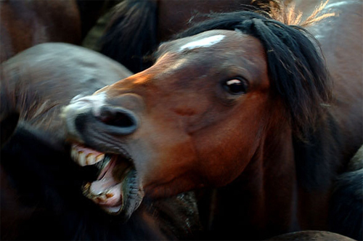
Equine bites

Slide 17
Larson v. xyz insurance co. 2016 la. App. Lexis 578; 2015-0704 (la. App. 4 cir. 03/23/16)
A sad story about Wesley, the equine, and Ms. Larson, a kind visitor to the City of New Orleans
Wesley is a horse housed at City Park and owned by Equest, an equestrian facility at City Park. Wesley and the other horses board there and are used for camps, family trips, field trips, birthday parties
Ms. Larson, was a young woman in town visiting her boyfriend who went to Equest to visit and feed the horses.

Slide 18
Ms. Larson testified that she just wanted to “see” the horses, “feed them treats” and “give them “love and affection”

Slide 19
The incident…
Ms. Larson drops a carrot
Both she and Wesley go for it at the same time.
Wesley bites off Ms. Larson’s thumb

Slide 20
Trial Court granted summary judgment for Equest, ruling that Ms. Larson was engaged in equine activities, and that Equest was immune under the Equine Immunity Statute
Appellate Court held that Ms. Larson was not engaged in equine activities, but was a spectator
Case was remanded to the trial court to determine the immunity question with Ms. Larson as a spectator

Slide 21
La. R.s. 9:2795.3(B) equine immunity statute
Equine Activity Sponsors shall not be liable for injury or death of a participant when such injury or death results from the inherent risks fo equine activities
The statute goes on to define equine activity: (a) an equine show, auction, fair, race, competition, performance, parade or carriage ride; (b) equine training or teaching; (c) boarding; (d) riding, inspecting, or evaluating; (e) a ride, trip, hunt,

Slide 22
Summary of bite law in Louisiana
Dogs: Strict Liability. However, the two decisions this year seem to suggest knowledge on the part of the owner
Other domestic animals: Cats clearly get “one scratch”. Horse owners did not argue regarding the dangerous propensity of the heart. Might be useful if other horse owner did not know of the horse’s dangerous propensity

Slide 23
DOGFIGHTING
STATE V. JOHNSON, 2016 La. App. Unpub. Lexis 107; 2015 0434 (La. App. 1 cir 04/15/160
Animal Control responded to Mr. Johnson’s property on a welfare call
They found several dogs in horrible condition
The State presented a circumstantial case against Mr. Johnson for dogfighting by presenting evidence of how the animals were housed, their injuries, etc.
The appellate court upheld Mr. Johnson’s conviction.
Signals a possible shift in the attitude of the Courts to dogfighting

Slide 24
Animal Shelter Registry
SB216 enacted La.R.S. § 3:2364(D)(11) and 3:2366 which create a voluntary registration of animal shelters and the provision of certain records so that statistics of animal shelters can be monitored by the Animal Welfare Commission. This statute gives authority to the Louisiana Animal Welfare Commission to establish and maintain the Louisiana Animal Shelter Registry.
SB216 as originally written provided for animal shelters to be required to submit information to the Commission. A Senate amendment changed the language to voluntary registration and provision of information.
The bill was signed into law by the Governor and became effective on August 1, 2016.

Slide 25
This legislation was introduced due the lack of any oversight of public animal shelters in Louisiana. Prior to the introduction of this legislation, there were no statistics provided or maintained on animal shelters. The information provided by the shelters will help to ensure their compliance with minimum standards for animal shelters as required in La. R.S. 2461) and the pet overpopulation control act (La. R.S. 2471).
Louisiana shelters that choose to comply will submit data through the basic animal data matrix on the national Shelter Animals Count data collection website www.shelteranimalscount.
It was clearly a blow that the mandatory language of the original bill was stricken, but the prevailing belief of animal advocates in Louisiana is that the law is a good initial step, and that in future legislative sessions the voluntary language can be amended to mandatory language.
Given the current lack of oversight, and the inhumane conditions found at many public animal shelters in Louisiana, the statute seems to be a step in the right direction to recognize that the information sought has value, and can be beneficial in assessing the compliance of animal shelters with spay and neuter laws, adoption rates, and minimum standards of care for shelter animals.

Slide 26
Limitations on pet store animals
SB337 limits the sources from which pet stores can obtain the animals they sell by enacting La.R.S. 3:2511. The law went into effect on June 17, 2016, and provides that retail pet stores may only obtain their animals from an animal shelter, animal welfare organization, or certified breeder.

Slide 27
The intent of the statute is to restrict pet stores from getting puppies from puppy mills or other less than reputable breeders. The enactment of the law will limit pet stores to obtaining dogs and cats from animal shelters, non profit animal rescue organizations, and limited breeders.
In order to obtain an animal from a breeder, the breeder must:
Not have more than 75 dogs at one time which are over the age of one and used for breeding purposes;
Hold a Class A license with the USDA which has not been suspended within the last 5 years
Be free of direct violations for the three years preceding the purchase of the animal;

Slide 28
Have three or less indirect violations during the three years preceding the purchase of the animal;
Not been cited on the two most recent inspection reports for no-access violations.
And, the pet store must have a sign on the cage of the animal which has the breeder’s name and USDA license number
Other requirements include record keeping on the animal and its origin, and not selling puppies under 8 weeks of age.
The legislation will prevent pet stores from selling dogs and cats from puppy mills and similar breeders, and will also give these breeders one less avenue to sell their animals.

Slide 29
Theft of pets
SB 435 enacted La. R.S. 14:67.30 created a misdemeanor crime of theft for taking, killing or holding for ransom the pet of another. If the person has two or more convictions, the third conviction is a felony.
The Act was effective August 1, 2016

Slide 30
The original bill created a series of different level felony offenses depending on the circumstances of the theft. The Senate amended the bill to its current state which still creates a crime for behavior which was previously not punishable except under regular theft of property statutes.

Slide 31
Burial of pet remains with human remains
SB166 would have provided for persons to have the remains of their pets buried with them. The bill was tabled for this session with the idea that it would be brought back next session after consult regarding similar statutes in other states such as New York, New Jersey, Pennsylvania and Virginia.
Those states allow for human and pet remains to be buried together either in pet cemeteries or in special sections of human cemeteries.

