Slide 1

Dogs shot by police officers

Slide 2

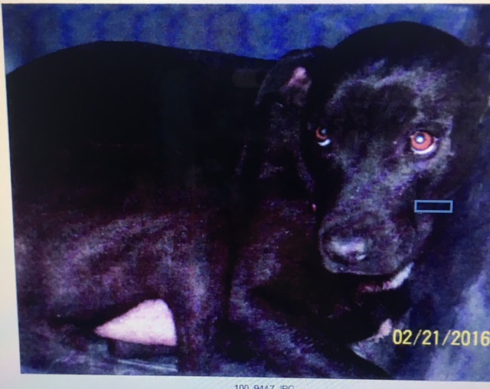

My cASES
CARPENTER V. CITY OF SULPHUR – Settled
SONNIER V. ACKAL- pending
VIDRINE V. ACKAL- pending
WILLIAMS V. MOSES- pending
ROBINSON V. MOSES- pending

Slide 3

Carpenter v. City of Sulphur
ARZY KENZINGTON
(NEWFOUNDLAND LABARDOR MIX)

Slide 4
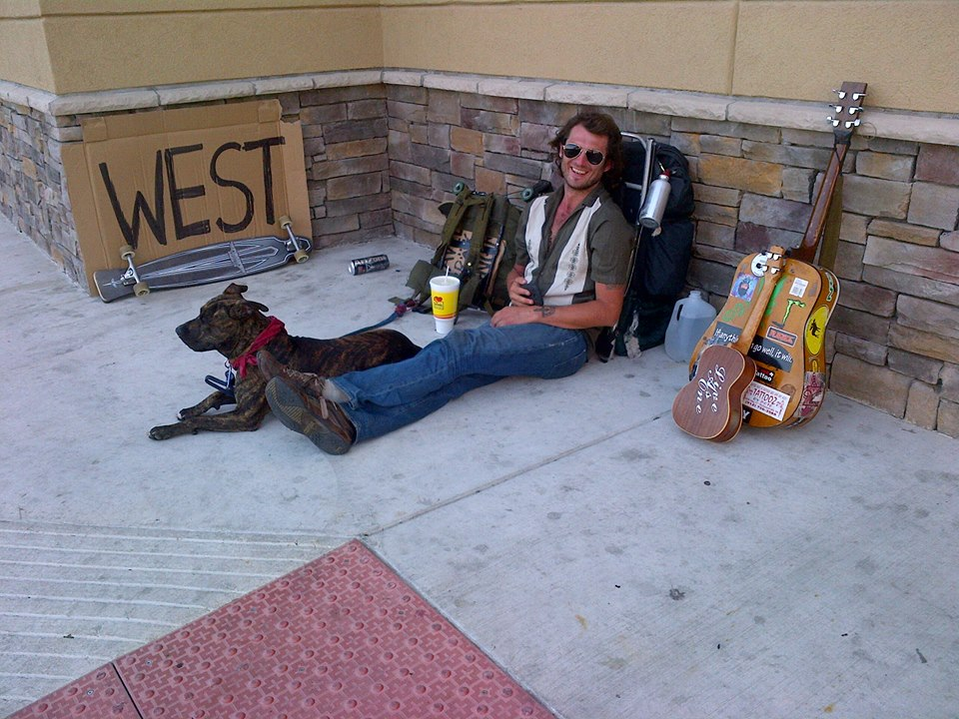
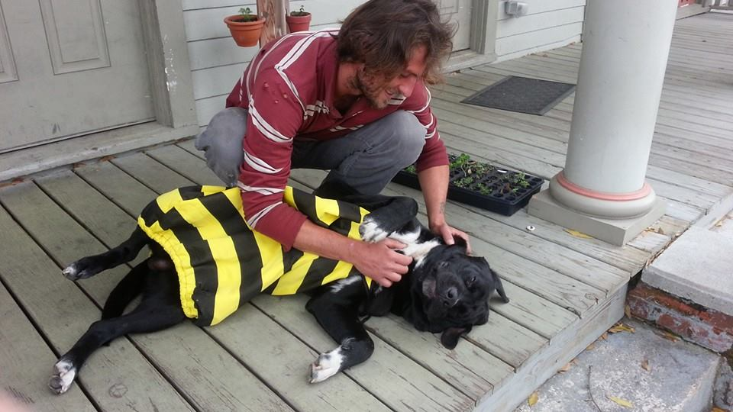
BRANDON
Arzy’s owner

Slide 5
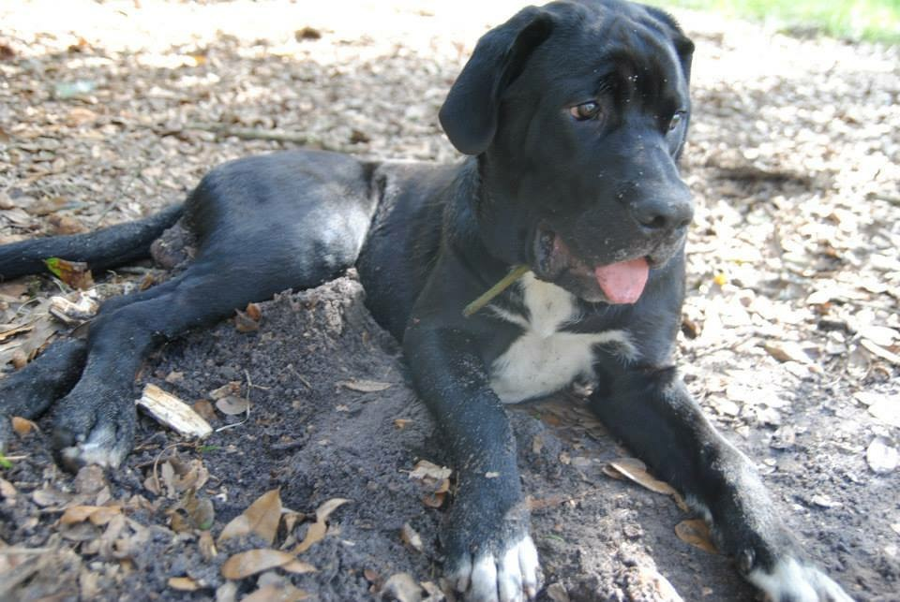
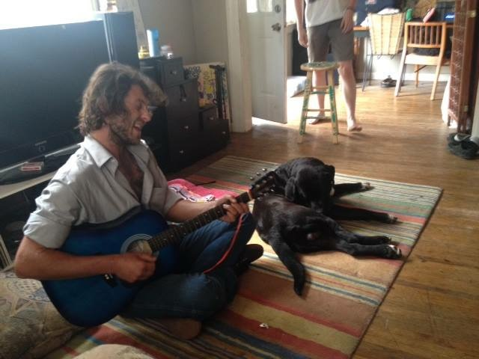

Slide 6


Brandon

Slide 7
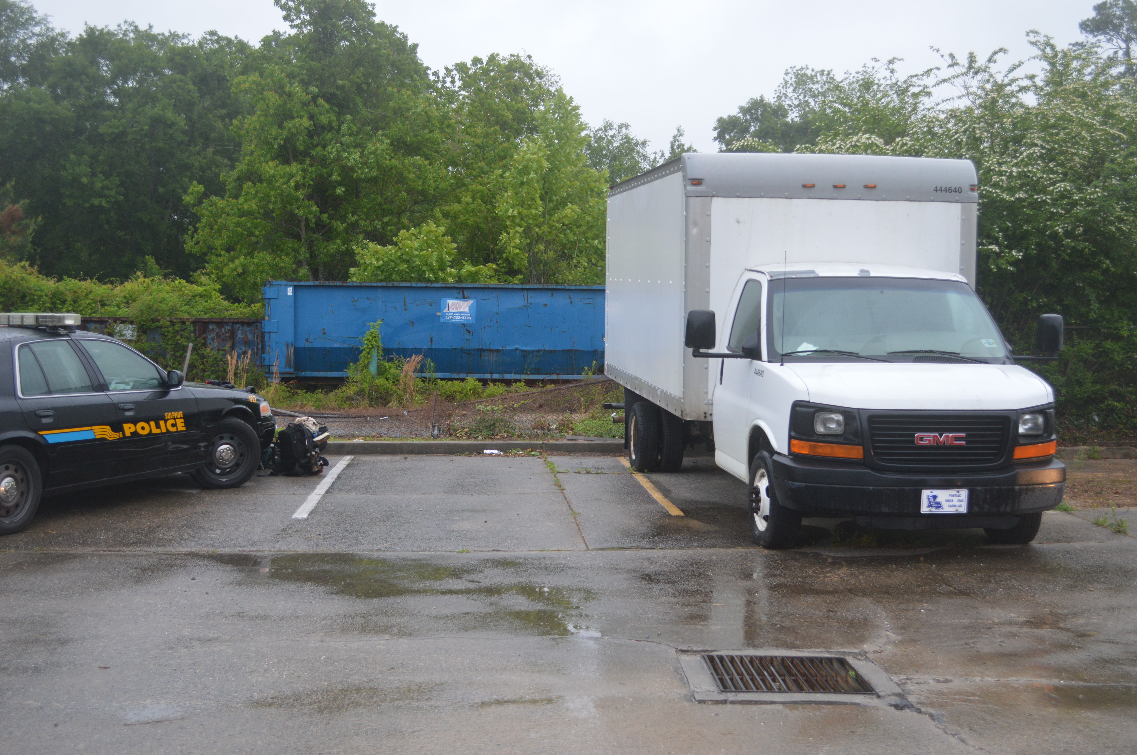

Slide 8
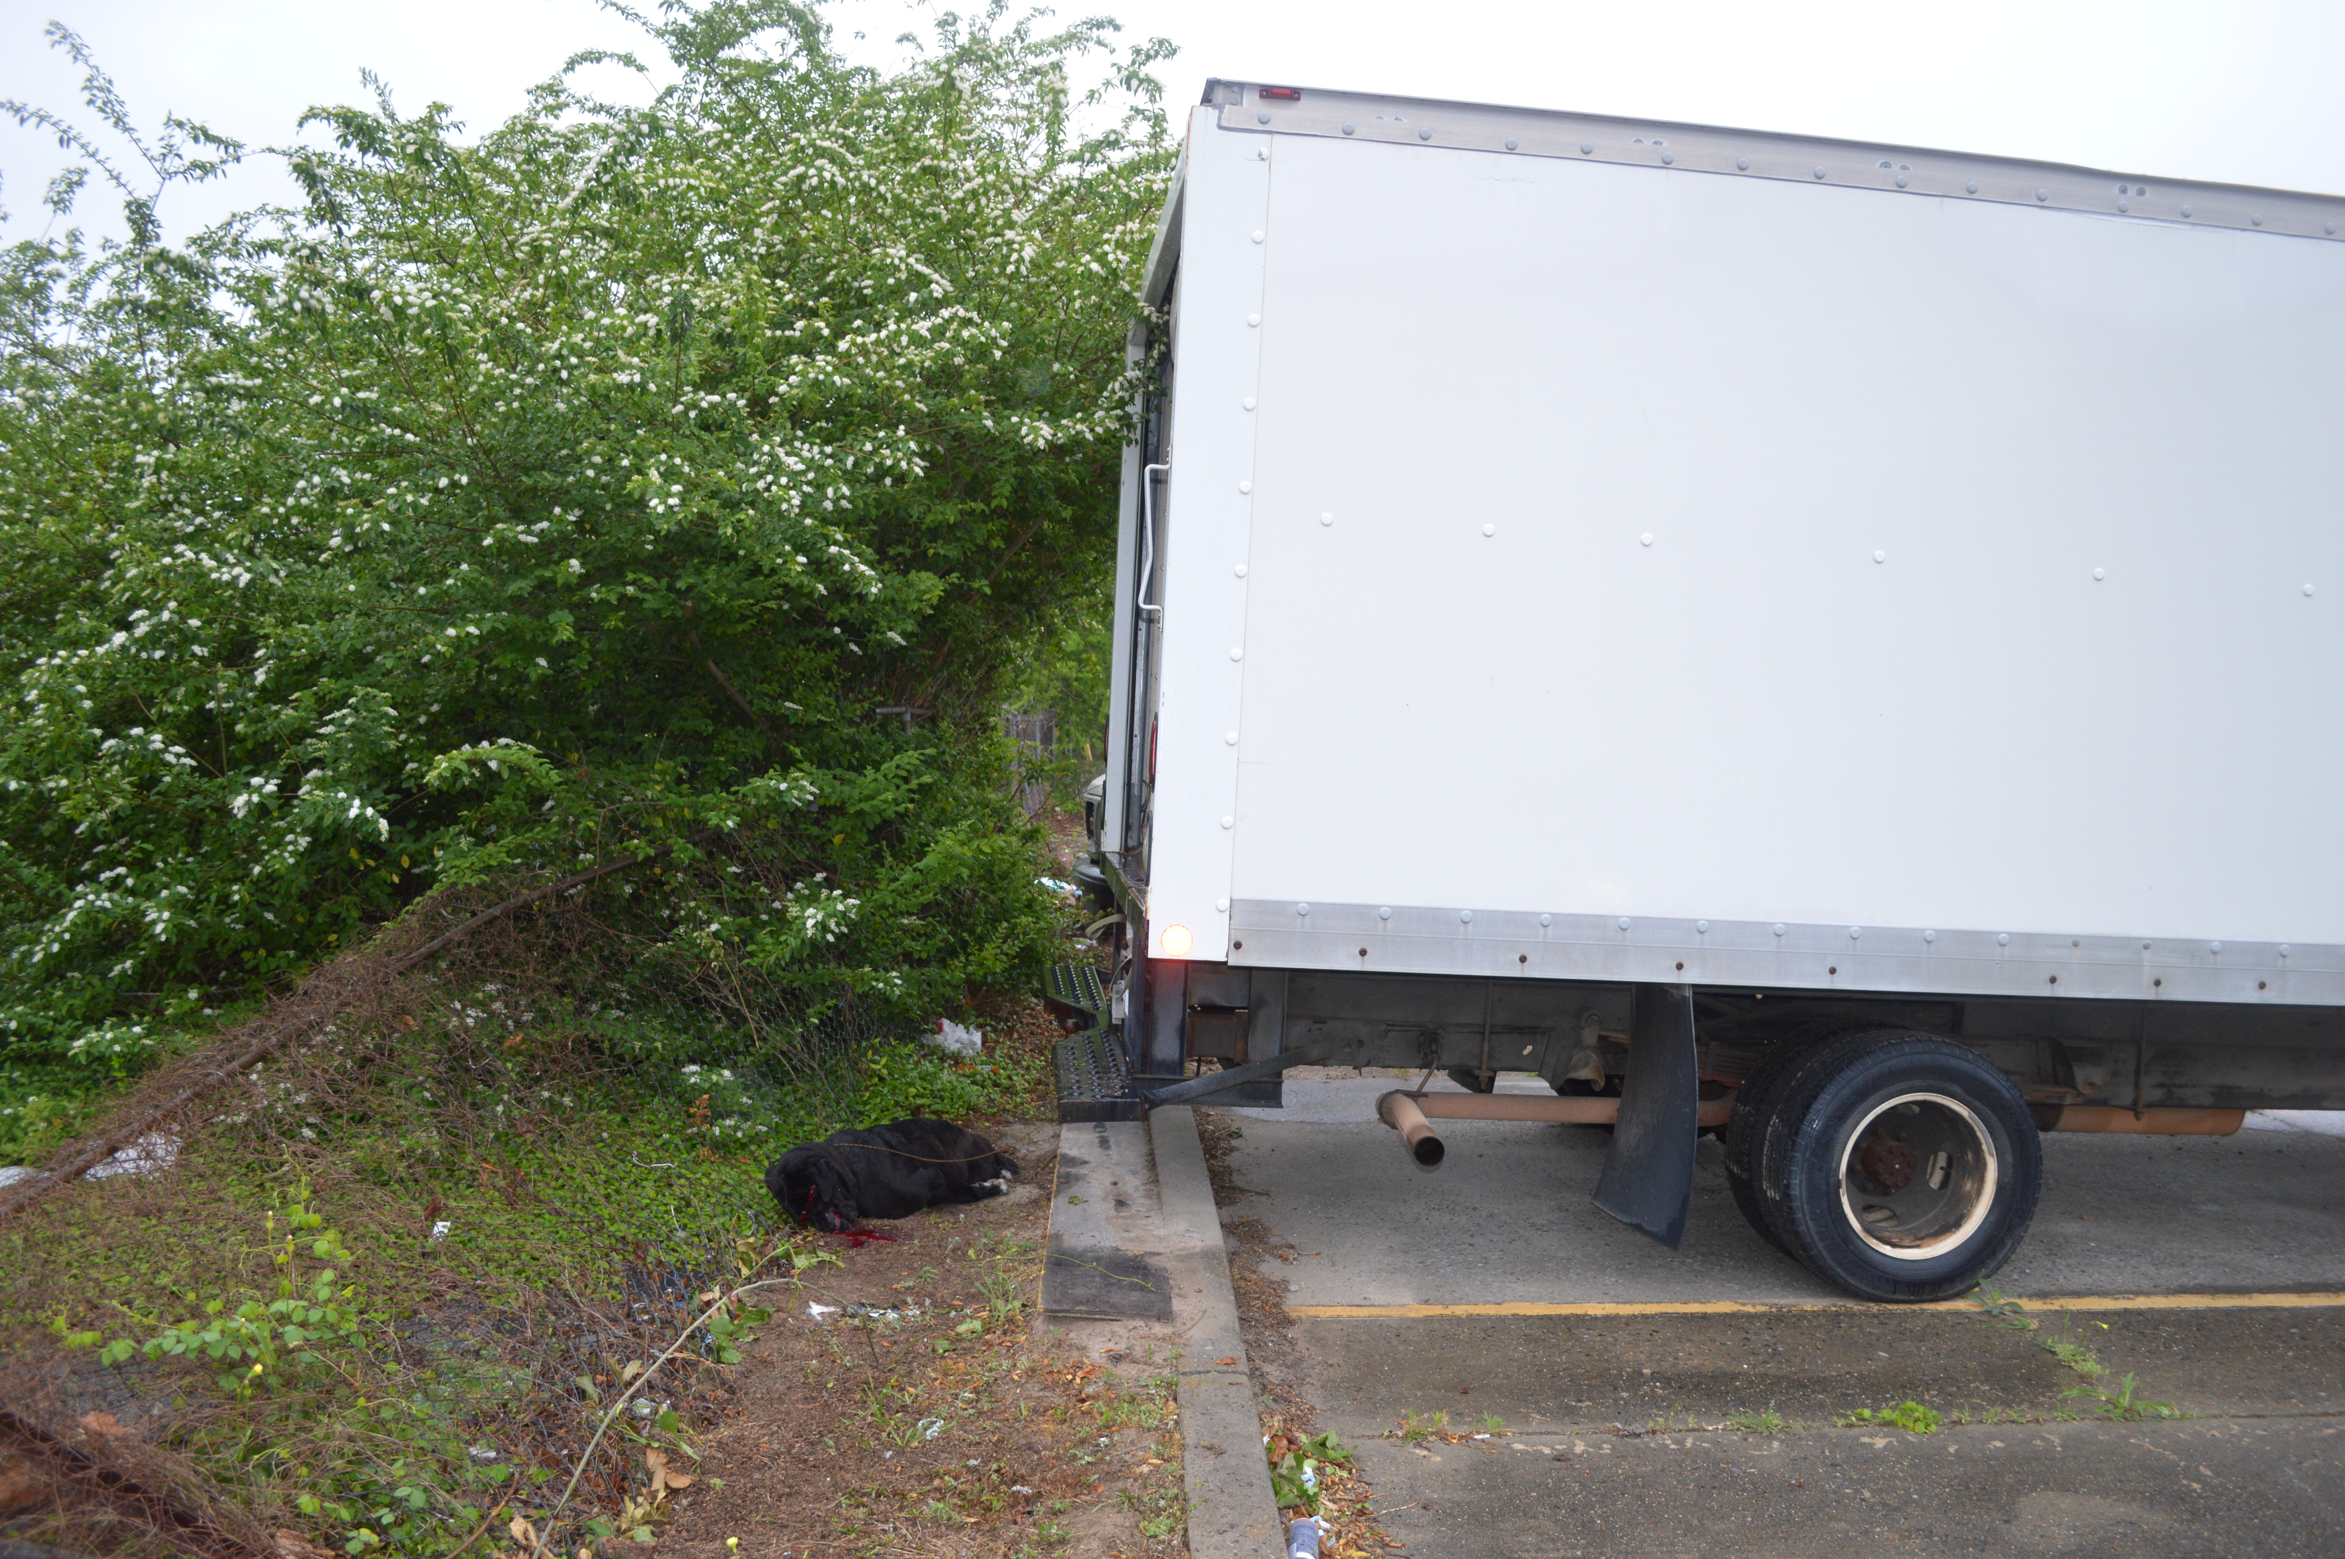

Slide 9
Step 1- PRESERVATION OF EVIDENCE
Immediately send a letter to the appropriate law enforcement agency, animal control organization, and attorney (if known) requesting to preserve ALL evidence in connection with the shooting and information on the Shooter/officer.
This also includes a request to preserve the remains of the animal.**

Slide 10
Step 2 foia request
                Louisiana Public Records Act § 44:1 et. seq.
§31. Right to examine records
A. Providing access to public records is a responsibility and duty of the appointive or elective office of a custodian and his employees.
B.(1) Except as otherwise provided in this Chapter or as otherwise specifically provided by law, and in accordance with the provisions of this Chapter, any person of the age of majority may inspect, copy, or reproduce any public record.
(2) Except as otherwise provided in this Chapter or as otherwise specifically provided by law, and in accordance with the provisions of this Chapter, any person may obtain a copy or reproduction of any public record.
(3) The burden of proving that a public record is not subject to inspection, copying, or reproduction shall rest with thecustodian

Slide 11
FOIA Continued
§32. Duty to permit examination; prevention of alteration; payment for overtime; copies provided; fees
A. The custodian shall present any public record to any person of the age of majority who so requests. The custodian shall make no inquiry of any person who applies for a public record, except an inquiry as to the age and identification of the person and may require the person to sign a register and shall not review, examine or scrutinize any copy, photograph, or memoranda in the possession of any such person; and shall extend to the person all reasonable comfort and facility for the full exercise of the right granted by this Chapter; provided that nothing herein contained shall prevent the custodian from maintaining such vigilance as is required to prevent alteration of any record while it is being examined; and provided further, that examinations of records under the authority of this Section must be conducted during regular office or working hours, unless the custodian shall authorize examination of records in other than regular office or working hours. In this event the persons designated to represent the custodian during such examination shall be entitled to reasonable compensation to be paid to them by the public body having custody of such record, out of funds provided in advance by the person examining such record in other than regular office or working hours.
B. If any record contains material which is not a public record, the custodian may separate the nonpublic record and make the public record available for examination.
C.(1)(a) For all public records, except public records of state agencies, it shall be the duty of the custodian of such public records to provide copies to persons so requesting. The custodian may establish and collect reasonable fees for making copies of public records. The custodian may request payment of fees in advance of production. Copies of records may be furnished without charge or at a reduced charge to indigent citizens of this state.
(b) For all public records in the custody of a clerk of court, the clerk may also establish reasonable uniform written procedures for the reproduction of any such public record. Additionally, in the parish of Orleans, the recorder of mortgages, the register of conveyances, and the custodian of notarial records may each establish reasonable uniform procedures for the reproduction of public records.
(c) The use or placement of mechanical reproduction, microphotographic reproduction, or any other such imaging, reproduction, or photocopying equipment within the offices of the clerk of court by any person described in R.S. 44:31 is prohibited unless ordered by a court of competent jurisdiction.
(d) Any person, as provided for in R.S. 44:31, may request a copy or reproduction of any public record and it shall be the duty of the custodian to provide such copy or reproduction to the person so requesting.
(2) For all public records of state agencies, it shall be the duty of the custodian of such records to provide copies to persons so requesting. Fees for such copies shall be charged according to the uniform fee schedule adopted by the commissioner of administration, as provided by R.S. 39:241.
Copies shall be provided at fees according to the schedule, except for copies of public records the fees for the reproduction of which are otherwise fixed by law. Copies of records may be furnished without charge or at a reduced charge to indigent citizens of this state or the persons whose use of such copies, as determined by the custodian, will be limited to a public purpose, including but not limited to use in a hearing before any governmental regulatory commission.
(3) No fee shall be charged to any person to examine or review any public records, except as provided in this Section, and no fee shall be charged for examination or review to determine if a record is subject to disclosure, except as may be determined by a court of competent jurisdiction.
D. In any case in which a record is requested and a question is raised by the custodian of the record as to whether it is a public record, such custodian shall within three days, exclusive of Saturdays, Sundays, and legal public holidays, of the receipt of the request, in writing for such record, notify in writing the person making such request of his determination and the reasons therefor. Such written notification shall contain a reference to the basis under law which the custodian has determined exempts a record, or any part thereof, from inspection, copying, or reproduction.

Slide 12
FOIA CONTINUED
§35. Enforcement
A. Any person who has been denied the right to inspect, copy, reproduce, or obtain a copy or reproduction of a record under the provisions of this Chapter, either by a determination of the custodian or by the passage of five days, exclusive of Saturdays, Sundays, and legal public holidays, from the date of his in-person, written, or electronic request without receiving a determination in writing by the custodian or an estimate of the time reasonably necessary for collection, segregation, redaction, examination, or review of a records request, may institute proceedings for the issuance of a writ of mandamus, injunctive or declaratory relief, together with attorney fees, costs and damages as provided for by this Section, in the district court for the parish in which the office of the custodian is located.
B. In any suit filed under Subsection A above, the court has jurisdiction to enjoin the custodian from withholding records or to issue a writ of mandamus ordering the production of any records improperly withheld from the person seeking disclosure. The court shall determine the matter de novo and the burden is on the custodian to sustain his action. The court may view the documents in controversy in camera before reaching a decision. Any noncompliance with the order of the court may be punished as contempt of court.
C. Any suit brought in any court of original jurisdiction to enforce the provisions of this Chapter shall be tried by preference and in a summary manner. Any appellate courts to which the suit is brought shall place it on its preferential docket and shall hear it without delay, rendering a decision as soon as practicable.
D. If a person seeking the right to inspect, copy, or reproduce a record or to receive or obtain a copy or reproduction of a public record prevails in such suit, he shall be awarded reasonable attorney fees and other costs of litigation. If such person prevails in part, the court may in its discretion award him reasonable attorney fees or an appropriate portion thereof.
E.(1) If the court finds that the custodian arbitrarily or capriciously withheld the requested record or unreasonably or arbitrarily failed to respond to the request as required by R.S. 44:32, it may award the requester any actual damages proven by him to have resulted from the actions of the custodian except as hereinafter provided. In addition, if the court finds that the custodian unreasonably or arbitrarily failed to respond to the request as required by R.S. 44:32 it may award the requester civil penalties not to exceed one hundred dollars per day, exclusive of Saturdays, Sundays, and legal public holidays for each such day of such failure to give notification.
(2) The custodian shall be personally liable for the payment of any such damages, and shall be liable in solido with the public body for the payment of the requester's attorney fees and other costs of litigation, except where the custodian has withheld or denied production of the requested record or records on advice of the legal counsel representing the public body in which the office of such custodian is located, and in the event the custodian retains private legal counsel for his defense or for bringing suit against the requester in connection with the request for records, the court may award attorney fees to the custodian.
F. An award for attorney fees in any suit brought under the provisions of this Chapter shall not exceed the amounts approved by the attorney general for the employment of outside counsel.

Slide 13
News/Social media/Criminal complaint
“Justice for Arzy” Facebook page. Have your client create their own social media page to bring awareness to the shooting.
“Dogs Shot by Police” Facebook page that tracks and reports officer-related dog shootings across the country.
Local news coverage
Have your client make a formal, criminal complaint against the officer. In the Arzy case, we were able to successfully have the officer charged with felony animal cruelty. *Note: However, this may affect your FOIA request due to “pending criminal investigation.”
If criminal charges are pursued, have your client register as a “victim” with the local District Attorney Office.

Slide 14
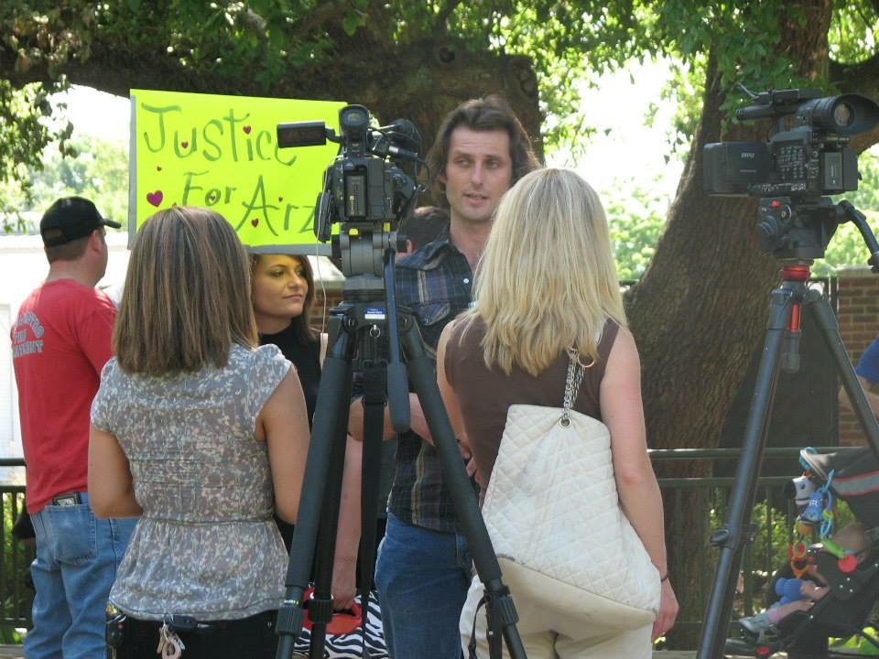

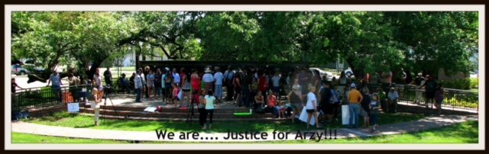

Slide 15
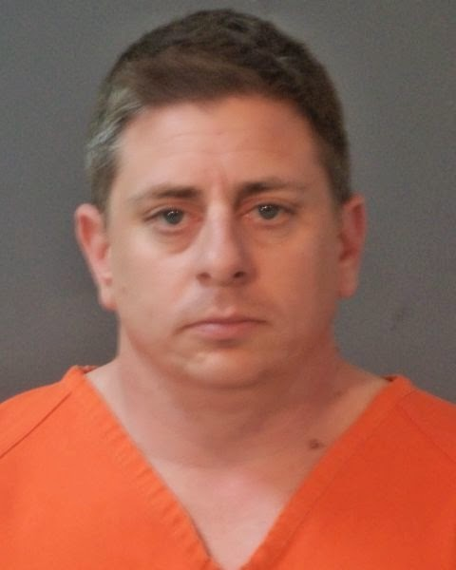
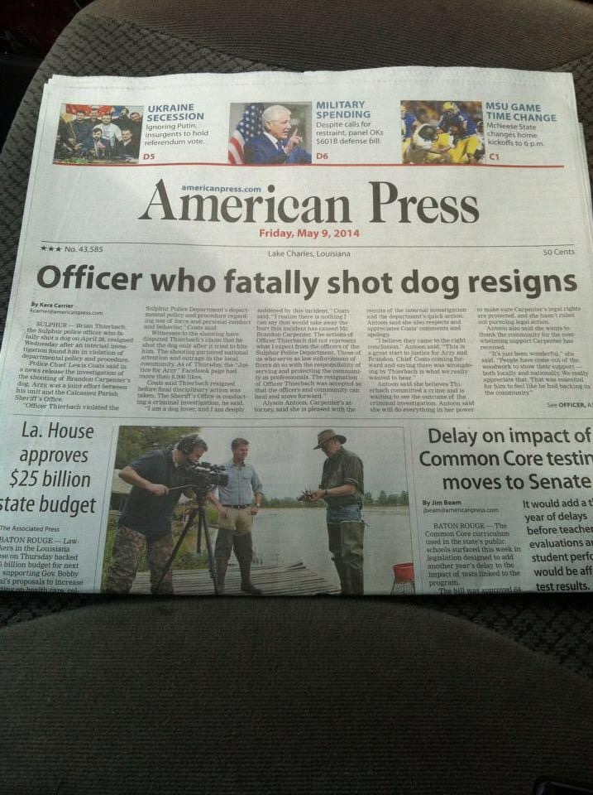
BRIAN THEIRBACH

Slide 16
FILING SUIT

Slide 17
U.S.C. §1983
§1983 is the primary vehicle for obtaining damages against State and local actors/officials (law enforcement officers) who violate the constitution.
1983 enables persons whose constitutional rights have been violated to sue the wrongdoer PERSONALLY for redress. Liability will attach if (1) defendant has acted under color of state law and (2) the defendant’s action deprived the plaintiff of some right, privilege or immunity secured by the constitution or federal laws. Monroe v. Pape. 365 U.S. 167 (1961).

Slide 18
§1983 Continued
Monroe also held that a §1983 remedy is supplemental to any remedy under state law. Thus, the plaintiff need not exhaust all available state remedies as a precondition to bringing suit in Federal court.
An official can act “under color of” law even when he violates state law and commits acts that state law would not authorize or sanction.
The Monroe court also concluded that it was irrelevant that the officers’ particular actions may not have been authorized or sanctioned by the City in some formal sense. It was enough that the officers were performing their job when they violated the constitution. The Officers were exercising the general governmental power that they possessed. Even extraordinary deviations from acceptable practice may be considered under color of law if the harm was materially aided by the power and authority given by the state to a particular actor.

Slide 19
MUNICIPAL LIABILITY UNDER 1983 and Monell
.
You CAN sue cities, counties, and other Local government entities under $1983. Monell v. New York City Dept of Social Services 463 U.S. 658 (1978) held that cities were among the “persons” who could be sued under 1983.
HOWEVER, local government will be accountable ONLY IF the plaintiff can show that the official acted pursuant to some law, custom, or policy of the governmental entity. If local government can be liable because its official acted pursuant to some custom or policy, the entity itself cannot claim any kind of good faith or other immunity- even if its official might be able to raise such a defense.
The supreme Court has held that not just formal legislative enactments , but also the individual decisions of those who are final policy makers can subject local governments to monetary liability. Example: Failure to train and properly screen can subject it to liability for other apparently random and unauthorized unconstitutional acts.
NOTE: Local governments are not liable on a vicarious liability or respondeat superior basis under 1983. However, you can assert those under state law claims.

Slide 20
Qualified Immunity
Law enforcement and most other administrative officials enjoy qualified immunity, which enables them to avoid personal damages liability if they can show that they acted in objective good faith- i.e. that a reasonable officer would not have known that his actions violated the constitution. Harlow v. Fitzgerald, 457 U.S. 800 (1982).
The good faith immunity test is said to be “objective” – would a reasonable official have known that his actions violated the constitutional rights of the 1983 plaintiff? If not, the defendant officer will not be liable.
Thus, State and local officers will be personally accountable in 1983 actions only when their unconstitutional acts violate clearly established constitutional rights of which a reasonable official would have known.

Slide 21
DASH CAMERA VIDEO

Slide 22
caselaw
“The killing of a person's pet dog or cat by the government without the person's consent is also a seizure within the meaning of the Fourth Amendment.” Maldonado v. Fontanes, 568 F.3d 263, 271 (1st Cir. 2009)
There is a unique emotional attachment between a domestic animal and its owner; this attachment makes their seizure all the more severe. The emotional attachment to a family's dog is not comparable to a possessory interest in furniture. San Jose Charter of the Hell’s Angels Motorcycle Club v. City of San Jose (“Hell’s Angels”), 402 F.3d 962, 975 (9th Cir. 2005)
The seizure of a domestic animal is unreasonable when the animal does not pose an imminent danger to human life. Brown v. Muhlenberg Twp., 269 F.3d 205, 210 (3d Cir. 2001). Brown provides that the “officer was not entitled to qualified immunity for shooting a dog when the dog “posed no imminent danger” its owners were “known, available, and desirous of assuming custody
Incidents involving a dog that “has not actually attacked a person” are closer cases and can demonstrate that the deadly force was unreasonable. Altmanv. City of High Point, N.C., 330 F.3d 194, 205 (4th Cir.2003)
A seizure of an effect without a warrant is presumptively unreasonable. United States v. Place, 462 U.S. 696, 701 (1983). Therefore, “[i]n order for the officers’ warrantless seizures of the plaintiffs’ dogs to be constitutional, the seizures must have been reasonable.” Altman v. City of High Point, N.C., 330 F.3d 194, 205 (4th Cir. 2003)

Slide 23
CASE LAW CONTINUED
the use of deadly force against a pet is reasonable ONLY IF the pet poses an immediate danger and the use of force is unavoidable.” Viilo v. Eyre, 547 F.3d 707, 708 (7th Cir. 2008).
The availability of non-lethal means tends to show that Officer Price’s use of lethal force was unreasonable. Andrews v. City of West Branch, Iowa, 454 F.3d 914, 918 (8th Cir. 2006).
“the failure to develop any realistic non-lethal plan for dealing with the dogs is simply not the type of reasonable mistake in judgment to which a court should give deference in determining whether the officers are entitled to qualified immunity.” Hells Angels.
that an officer had a duty to employ “all means of capturing an at-large dog . . . before resorting to killing the animal. Andrews v. City of W. Branch, 454 F.3d 914, 919 (8th Cir. 2006).
In Hell’s Angels, the Ninth Circuit concluded that it was unreasonable to shoot even an attacking dog when the police could have avoided confrontation with the dog altogether. In assessing the reasonableness of the seizure, the court considered not just the ultimate decision to shoot the dogs but the entire planning and execution phase of the search.

Slide 24


Slide 25


Slide 26
$$$$$$ DAMAGES $$$$$$
What is the death of a companion animal worth?
Wide range!! Anywhere from 10k- 200k.
Punative damages
Attorney fees
Recent cases:
  Harris v. O’Hare et al no. 12-4350 (2nd Cir. 2014). Connecticut jury awards $202,000 to man, daughter whose dog was killed by Hartford Police.
  Branson v. Comerce City Police, Robert Price. 13-cv-03090-REB-NYW (D. Colo sept 24, 2015). City of Commerce, CO, paid settlement of $262,500 to the family of a chocolate-lab mix named Cloe, who was shot and killed by police while she was held on a catch pole. (Officer in that case was also charged with aggravated animal cruelty, but was acquitted).

Slide 27
Outcome of the arzy case
Civil case settled. Confidentially agreement. But still subject to FOIA??? Typically a confidentiality agreement only applies to the plaintiff. The city of Sulphur has refused to respond to FOIA requests regarding the settlement. Can sue for writ of mandamus, injunctive/declaratory relief, and can recover attorneys fees, costs, and damages.
Criminal case- plea agreement of “no contest” to misdemeanor animal cruelty. Officer only received a $250.00 fine and 1 year of UNSUPERVISED PROBATION under article 894.
Hopefully change in procedure

Slide 28

Brandon today

